Slide 1
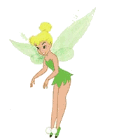
The Evolution of Pediatric Nursing's Past Illuminating Future Possibilities : Where are We Going?
This Photo by Unknown Author is licensed under CC BY
Linda A. Lewandowski Lynn D. Mohr
PhD, RN, FAAN PhD APRN PCNS-BC CPN FCNS

Slide 2
Presenters
Linda A. Lewandowski, PhD, RN, FAAN
SPN Past President 2002-2004
Dean and Professor
Kirkhof College of Nursing
Grand Valley State University
Grand Rapids, MI
Lynn D. Mohr PhD APRN PCNS-BC CPN FCNS
SPN Past President 2008-2010
Associate Professor and Department Chair
Pediatric and Neonatal CNS Program Director
Rush University College of Nursing
Chicago, IL

Slide 3
Disclosures
Dr. Lewandowski- none
Dr. Mohr serves as a consultant to Coloplast Corp. Denmark

Slide 4
Learning outcomes for today
Describe some historical events and practices that have influenced the development of pediatric nursing in the U.S.
Examine the evolution of pediatric nursing practice, education, and research and factors affecting where we are today.
Discuss the future of excellence for pediatric nursing.

Slide 5
What is the one Thing that most Influenced you to chose to be a Pediatric Nurse?

Slide 6
historical events that influenced the development of pediatric nursing in the U.S.

Slide 7
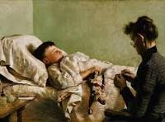
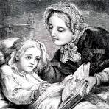
PRE-NINETEENTH CENTURY
Sick children were cared for at home.
Certain individuals developed a vast knowledge of medicinal plants, herbs, poultices for treating infections from injuries, and general health-related practices.
These “healthcare providers” were typically women who were held in high respect by members of their community.
Their roles and practices laid the foundation for what would become early professional nursing in America.

Slide 8
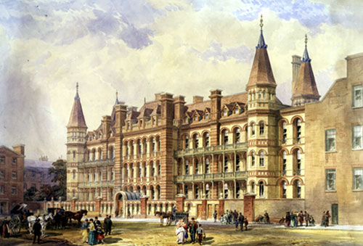
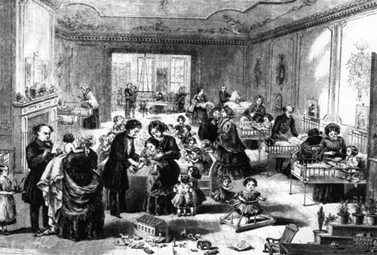
MID-NINETEENTH CENTURY: THE EMERGENCE OF PEDIATRIC CARE
Recognized that children require specialized medical attention distinct from adults marked a pivotal shift in healthcare.
This led to the establishment of dedicated children's hospitals, beginning with Great Ormond Street Hospital in London (1852), the first pediatric hospital in the English-speaking world.
In America, this movement continued with the Children's Hospital of Philadelphia (1855), establishing the foundation for specialized pediatric care in the United States.

Slide 9
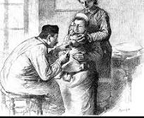
Mid-19TH – Early 20TH Century
Pediatric nursing during the nineteenth century focused on the child’s physical needs including: nutrition, hydration hygiene (sanitation measures), nurturance and safety
Key physical nursing observations included pulse, secretions, breathing, sleep, and wounds; key skills included noting symptoms, needs and changes
Notes:
Daily assignments included
Bathing and feeding patients
Sterilizing IV bottles, tubing and needles
Sharpening injection needles
Preparing formulas – sterilizing bottles and formula
Setting up oxygen tents when needed
Replacing used oxygen tanks
Round with the doctors and then following doctors’ orders
Play with the children to keep them happy
Record child’s response to medications and treatments

Slide 10
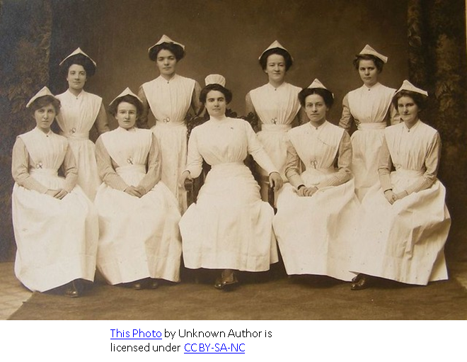
Mid-19TH – Early 20TH Century
1860 – Florence Nightingale established
St. Thomas Hospital
Nightingale Training School for Nurses.
She thought that children should not be separated but integrated in the same wards as adults (so female patients could assist with the care).
Nightingale stressed that nurses needed to have substantial scientific knowledge and appropriate technical skills.
Advocacy for nursing education helped Nursing become
an honorable profession for women.
Notes:
Whatever you do, do not have children’s wards in a general hospital but mix them up with the adults for where adults are mixed with them, the woman in the next bed, if the patients are judiciously distributed, often becomes the child’s best protector and nurse and it does her as much good as it does the child (Nightingale, 1859, cited in Miles, 1985, p.48).
Transformed– have professional standards, formal education requirements and social respect for the field.

Slide 11
Nightingale advocated that pediatric staffing should be double that of adult staffing
No child should be left alone and providing for developmental needs was as important as physical needs.
But that view shifted as care became more technical and prescribed.

Slide 12
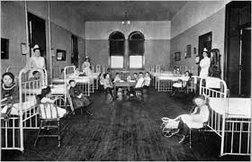
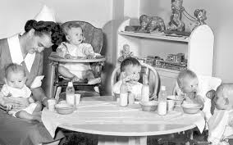
Role Of the Family in Pediatric Care
In early to mid 1900’s when children were admitted to hospitals, no parental visiting was allowed or perhaps half hour per week.
Even for long hospitalizations of even 2 years or more (e.g. chronic TB), children did not see their parents the whole admission.

Slide 13
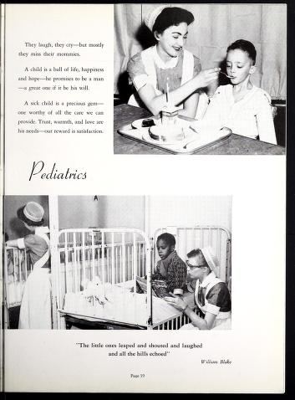
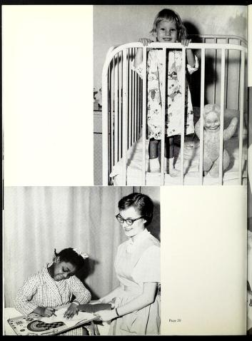
1959 ~
Parents were seen as interfering with care and were not allowed except for an hour on Sundays.
“Courtesy of the Rush University Medical Center Archives”
-This material is being shared with you for research, education, or personal use. For publication permissions or sharing beyond the scope of this project, contact the Rush Archives for further information.
Notes:
Since much of what we will be talking about clinically began during the 1950’s here are some pictures of practice during this time.

Slide 14
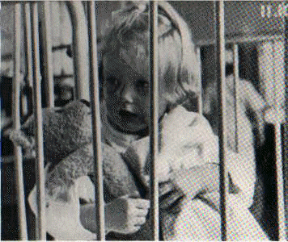
EARLY STUDIES of SEPARATION
The separation, suffering, and grief of World War II ushered in a movement of increasing concern for the psychological health of adults and children.
1945: Renee Spitz coined “hospitalism” to describe the decline in health of a child due to long confinement in a hospital
1952: James Robertson made a moving and very
influential film “ A Two-Year-Old Goes to the Hospital” of a child separated from her parents for 8 days.
This film drew attention to the plight of young patients at a time when visiting by parents was severely restricted.
https://youtu.be/s14Q-_Bxc_U?si=vtlRqTNa3q9Gk5WH

Slide 15
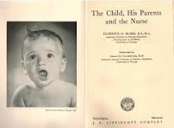
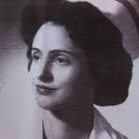
Events in the Evolution of PFCC: Research, Application, Advocacy
1954: Nurse Florence Blake- investigator-among first to describe benefits of collaboration between parents and nurse in care of hospitalized children
Her pediatric textbook, The Child, His Parent, and the Nurse, was used in many nursing schools----but did not immediately influence practice in terms of inclusion of parents.
The Citizens Committee on Children of New York City (1955) advocated for more “child-friendly ”hospitals, including allowing parents more access to their children”

Slide 16
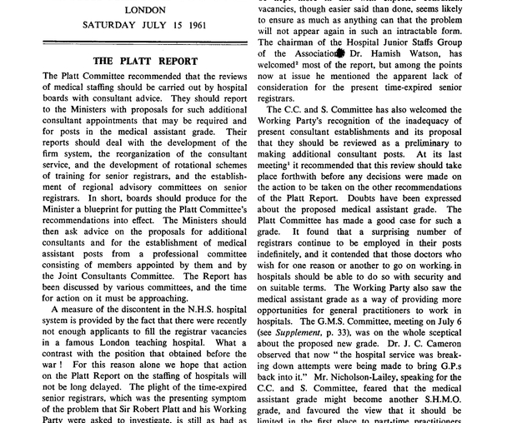
RESEARCH, REPORTS: A NEW MOVEMENT
Bowlby (1958; 1961) -Studies of attachment
In 1959, the British government published a report of an inquiry into conditions in children's hospitals, commonly known as the “Platt Report” (Ministry of Health, 1959).
In the 1960’s the “Rooming In” movement gained momentum.
More supportive research reports in next several decades

Slide 17
FAMILY ADVOCACY GROUPS
Family Advocacy Groups– such as Family Voices
–highly influential
Family advocates were essential to the passage
of the first special education law (P.L. 94–142) in
1975, the Early Intervention “Part C” several years later,
and the first Katie Beckett Home and Community-Based Medicaid Waiver
in 1982 that enabled many children and adults with disabilities and
chronic conditions to be cared for at home.
Family advocacy for children with special needs subsequently extended into the health care policy arena and spread...
With the backing of family advocates, the Maternal-Child Health Bureau and the U.S. Surgeon General sponsored several national conferences on children with special health care needs in the mid-1980s.
Notes:
.

Slide 18
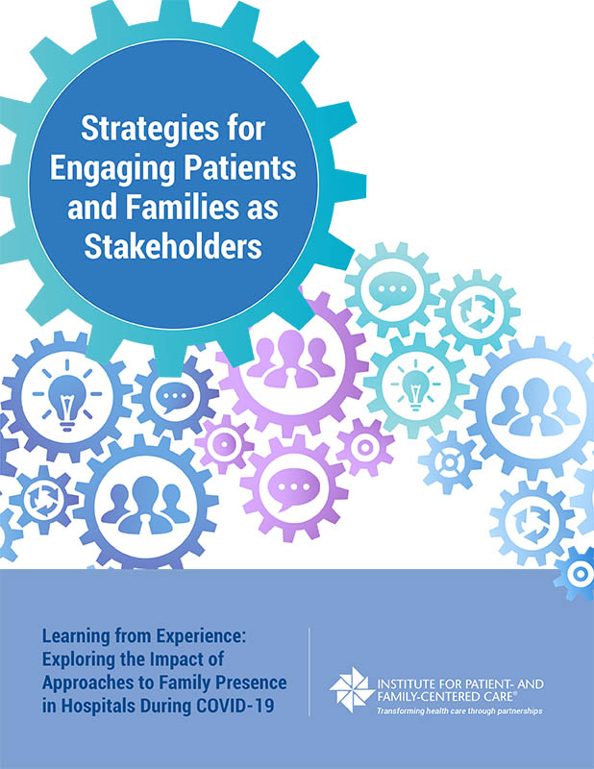
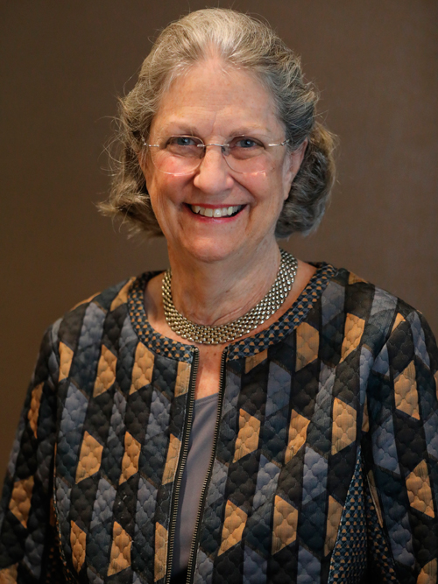
Evolution of PFCC
Beverly Johnson-- most to influence the widespread adoption of PFCC
Johnson was instrumental in forming the Association for the Care of Children’s Health in 1965 –an association for professionals AND for parents and family members--and subsequently, the Institute for Family-Centered Care in 1992.
This organization has evolved to the Institute for Patient and Family-Centered Care (https://ipfcc.org/) and still has a pivotal role in shaping many of the major health initiatives in the United States as well as the implementation of PFCC is many hospitals and health care institutions.
2001- Institute of Medicine identified PFCC crucial for health care quality.
Notes:
.Association for Care of Children’s Health formed in 1965– parents were able to join but due to funding and other organizations, disbanded in 1996.

Slide 19
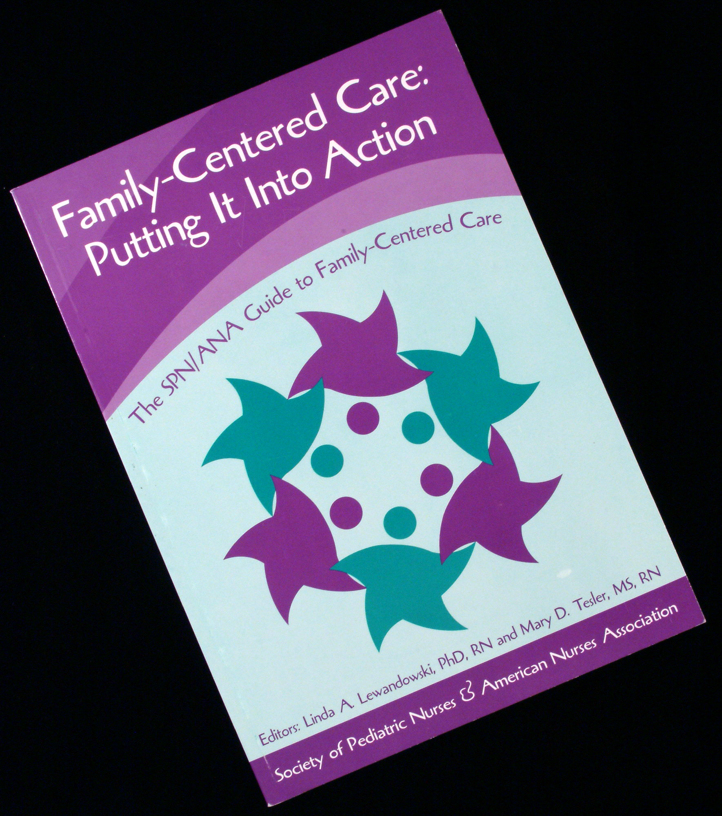
SPN has been a Leader in Family-Centered Care
SPN established a Task Force to amass an
evidence base for FCC
In 2003, SPN and ANA co-published a clinical
practice guideline in the form of a book:
“Family-Centered Care: Putting It Into Action
The SPN/ANA Guide to Family-Centered Care”
Authors: Linda A. Lewandowski and Mary D. Tesler
This guide provided an evidence base for 29 practice recommendations.

Slide 20
Patient AND Family-Centered Care Grew to Be “Standard of Practice”
2003- AAP incorporated into policy statements
2011- Present-- AHRQ one of six national priorities
2020-2030-Healthy People key outcome
Incorporated into the Mission, Philosophy, Values of most children's hospitals

Slide 21
Then the World Changed!! A Step Back… Patient and Family–Centered Care and COVID-19
In 2020, “Virtually overnight”, hospitals barred family members from being present with their ill family members and “commitments to patients/families/staff collaboration have been compromised, overwhelmed, and paralyzed.”
This resulted in a “Terrible push-pull between two approaches: (1) encouraging patient/family collaboration and presence; versus (2) protecting the public good.” (Crocker, 2020)
Since then, we having moving things back to a more inclusive model—but are we there yet?

Slide 22
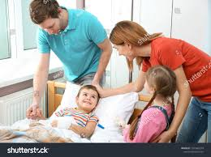
A question for You….
Where are we now?
Notes:
Discussion

Slide 23
evolution of Pediatric Clinical Care

Slide 24
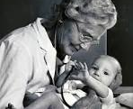
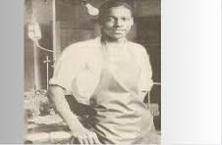
PEDIATRIC CARDIOLOGY
1930’s -Dr. Helen Taussig ~ opened clinic for rheumatic heart disease, innocent murmurs/congenital heart with fluoroscopy and x-rays
1938 1st surgery to ligate PDA ~ CHOB: Dr. Gross
1944 Blalock-Taussig Procedure -TOF
duct dependent cyanotic heart disease
Vivian Thomas~ paid as “janitor” , revolutionized cardiac surgery
Late 1950’s ~ cardiac catheterization/angiography
Notes:
Vivian Thomas—worked as a lab assistant with Dr. Balock—was categorized and paid as a “janitor’, but, is now credited with having been the pioneer who revolutionized cardiac surgery—although due to his race, he was given no credit at the time in 1976, Johns Hopkins awarded him an honorary doctorate and appointed him to the medical school faulty—he died in 1985.

Slide 25
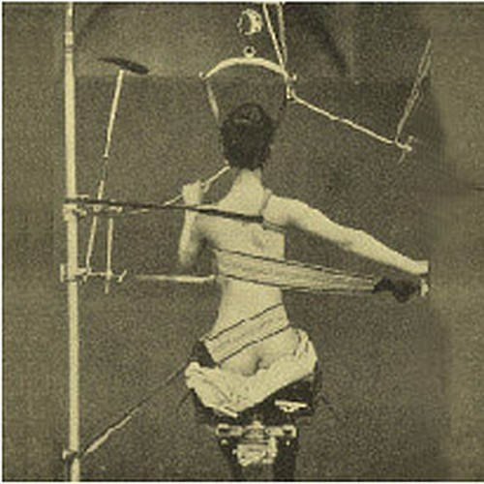
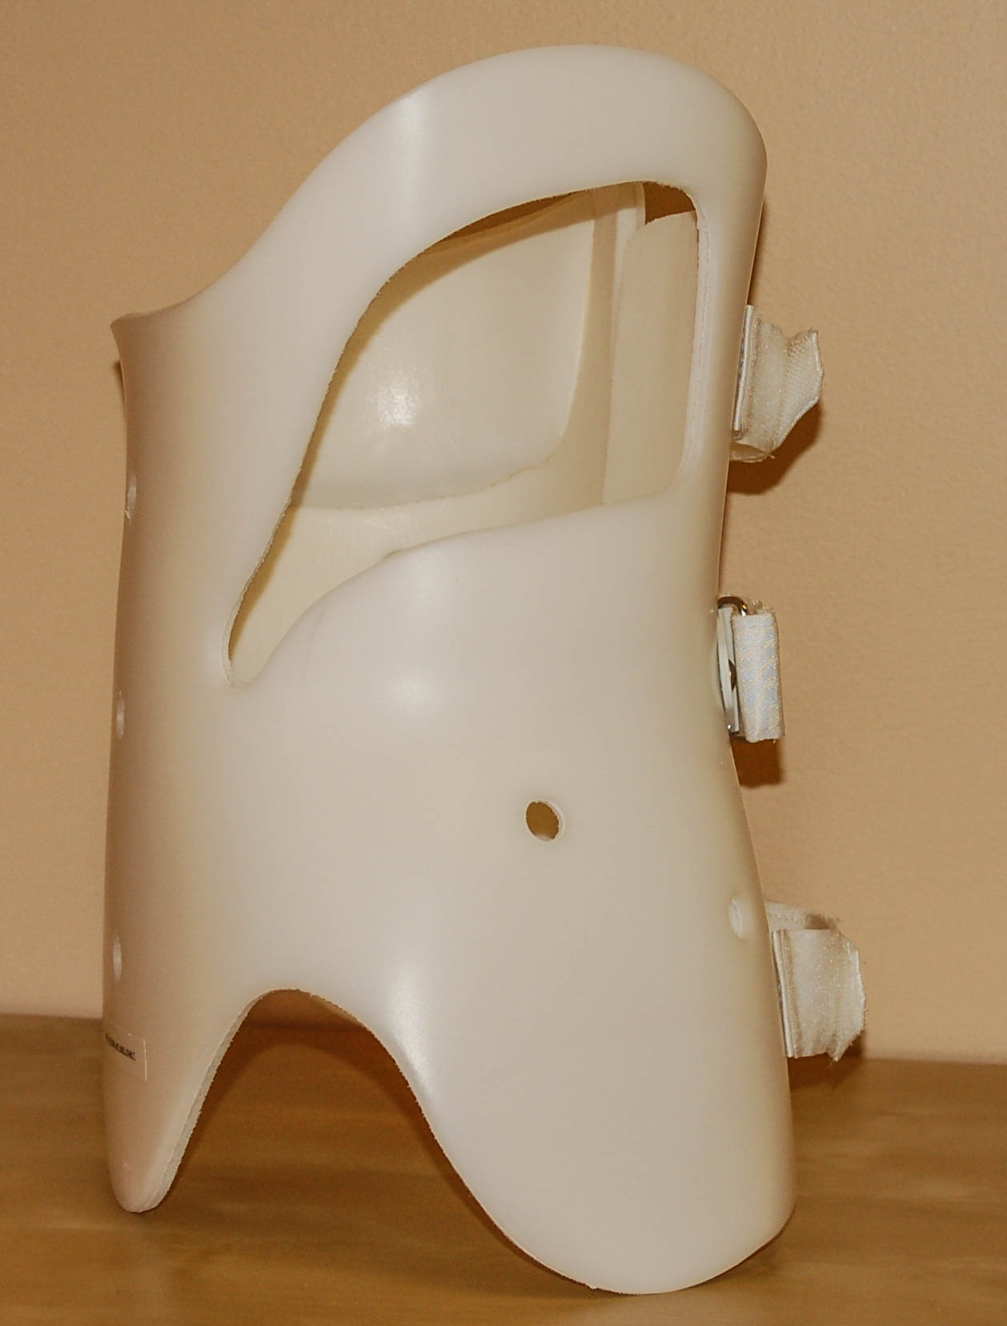
SCOLIOSIS
Photo unknown
https://www.ec-op.com/orthotics/
Notes:
From tying patients to sticks, the next step was the design of an actual brace; the first-known scoliosis brace was metal and was created in France in 1575.
Between 1950 and 2000, a variety of braces were designed and developed, the most commonly used being the Milwaukee and the Boston brace.

Slide 26
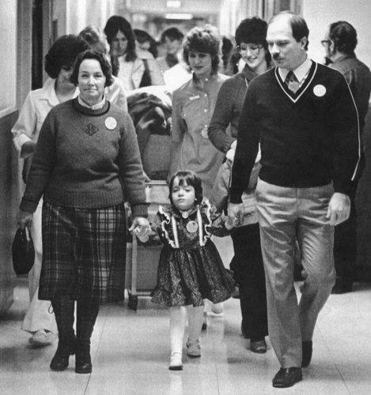
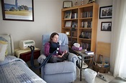
Reimbursement for Home CARE
Katie Beckett: contracted encephalitis and was hospitalized at 9 months.
She aspirated and developed RDS, placed on ventilator & was in a coma for 3 months. Awoke partially paralyzed.
Cared for in the PICU for the next 2 ½ years.
Notes:
Was the first Medicaid Home and Community-based Waiver child. The waiver was granted in 1981 and has become a vehicle for many persons with disabilities to receive care at home or in their communities. Before Katie’s death in 2012, she and her mother testified numerous times before Congress in advocating for children and their families.
We have already heard that her mom Julie was a founder of Family Voices (she passed away in 2022.)

Slide 27
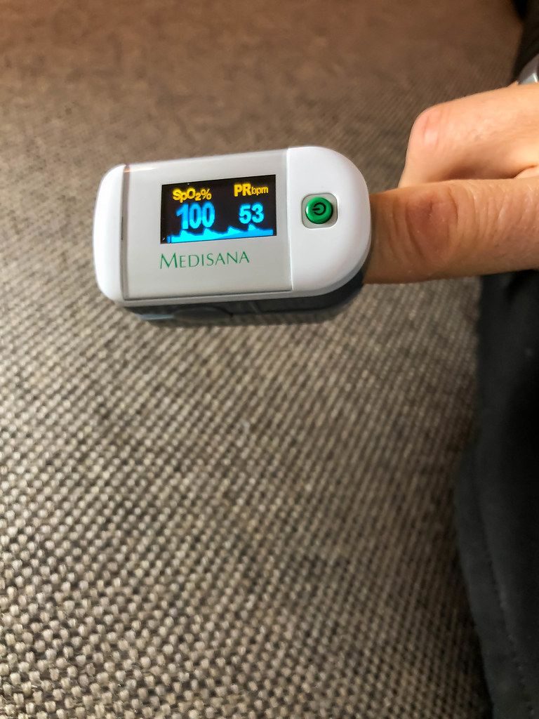
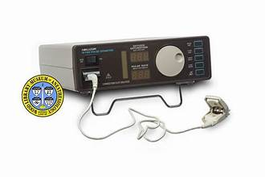
PULSE OXIMETRY
1944: Original~
1972: First used with patients
1987: Standard of care in the OR~
1995 Massimo: enhanced to limit patient movement
This Photo by Unknown Author is licensed under CC BY
https://r.search.yahoo.com/_ylt=Awrig7LbdvpnIjM5RgqjzbkF;_ylu=c2VjA2ZwLWF0dHJpYgRzbGsDcnVybA--/RV=2/RE=1744496475/RO=11/RU=https%3a%2f%2fwww.woodlibrarymuseum.org%2fmuseum%2fnellcor-pulse-oximeter%2f/RK=2/RS=Hdl25h.F0knzwjXKAgzmk1jN8sI- 1980’s

Slide 28
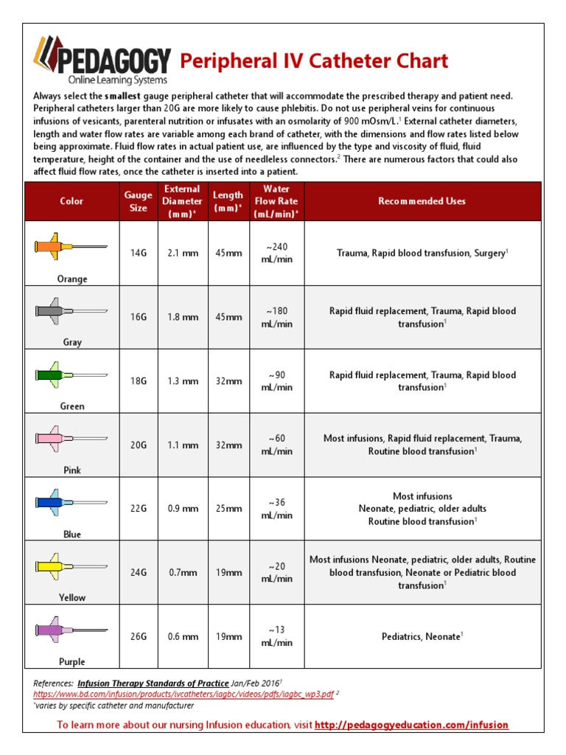
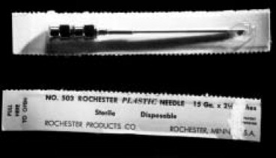
IV CATHETERS
Designed for patient comfort
https://r.search.yahoo.com/_ylt=Awrig7IFgPpnHeU6tMKjzbkF;_ylu=c2VjA2ZwLWF0dHJpYgRzbGsDcnVybA--/RV=2/RE=1744498821/RO=11/RU=https%3a%2f%2fwww.scribd.com%2fdocument%2f391960437%2fPeripheral-IV-Catheters-Chart/RK=2/RS=.u73plQGT3zsbRBqTwkD_uHb7hU-
1950’s Rochester needle
The Rochester Plastic Needle in its package. Photo courtesy of Ms. Diane Osland

Slide 29
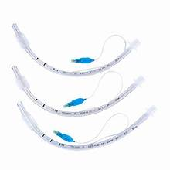
ET TUBES
1957
Formula for measuring pediatric ET-tube/tubes were plastic
1980’s
Routine use of endotracheal intubation in pediatrics
2004
Polyvinyl (Kimberly Clark) ET tubes
2005
Cuffed vs uncuffed ET tubes in children
Notes:
Tracheotomy practices have been recorded as early as 3600 BC according to some Egyptian tablets.
Due to availability of materials, most endotracheal tubes up until the 20th century were made from metal, which added to the potential for trauma during use

Slide 30
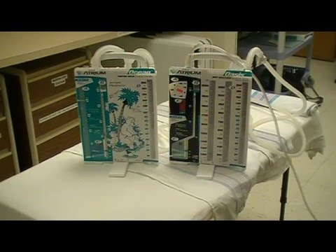
Chest Tube
Courtesy Atrium Chest tube
Notes:
1210 and 1220. He describes a knight named Gawan’s comments and action upon encountering a fallen knight named Uriens, who has sustained a chest wound in a joust- noted blood was pressing on his heart, so took a tree branch and peeled off the bark and had lady in waiting sucked on the branch.

Slide 31
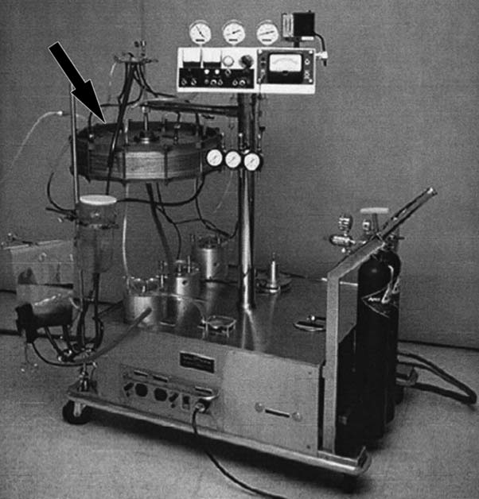
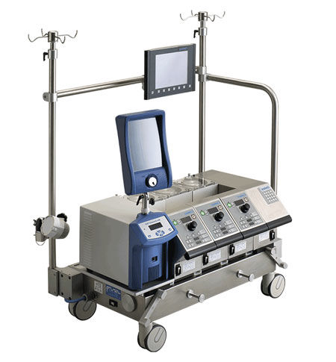
ECMO
Bramson Heart Lung machine
1970’s Today
Notes:
1950’s ~ concept of cardiopulmonary bypass
Advances in 1960/1970’s neonatal patient with hyaline membrane disease

Slide 32
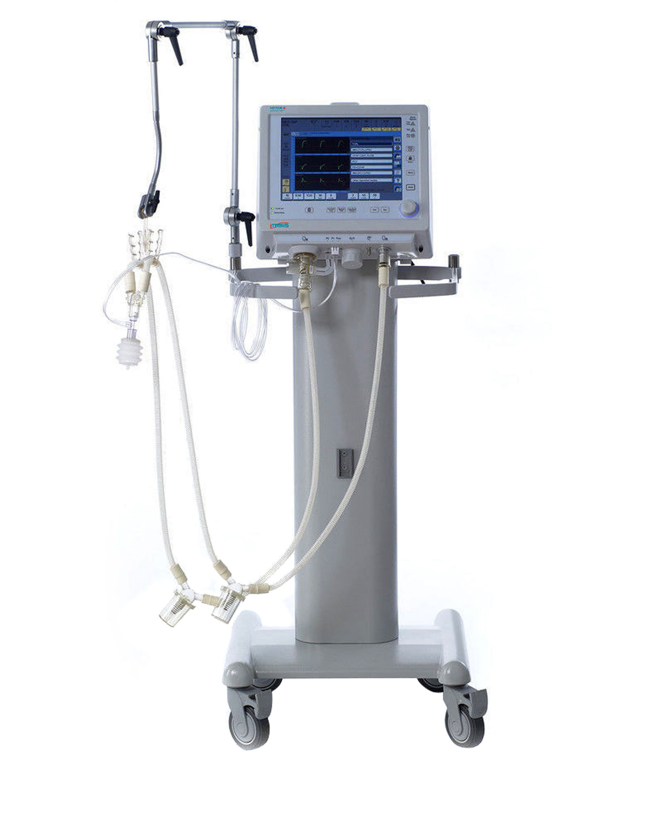
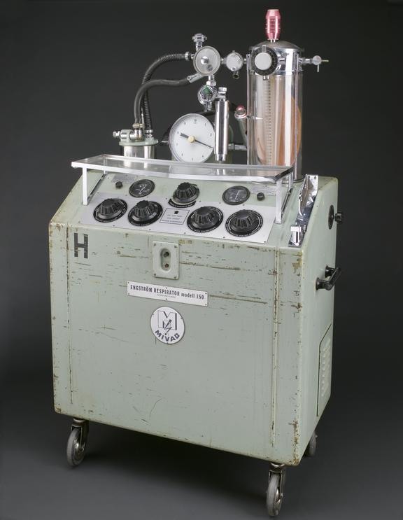
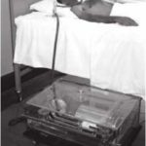
Ventilators
1950-1970 Engstrom Mueller-Mork (1959) Medsurge
respirator
https://museum.aarc.org/wp-content/uploads/2019/10/morch4-150x150.jpg
medsurge website, 2025
https://r.search.yahoo.com/_ylt=AwrhbtruhvpnuAIP4a.jzbkF;_ylu=c2VjA2ZwLWF0dHJpYgRzbGsDcnVybA--/RV=2/RE=1744500590/RO=11/RU=https%3a%2f%2fcollection.sciencemuseumgroup.org.uk%2fobjects%2fco75697%2fengstrom-respirator-model-150-sweden-1955-1970-anaesthetic-machine-ventilator/RK=2/RS=JfW6eISRhlOLrqFdxAnaygUtZUY-
Notes:
First called respirators
Some were designed to fit under the bed
The Mueller-Mork– had a night light so patient could be monitored during the night

Slide 33
Education evolution
First nursing textbooks ~ 1923
Articles addressing children’s needs much earlier (Ferrar,1906)
Florence Nightingale ~ Notes of Nursing (1895) emphasized care of children
Talked about the “pediatric nurse personality” (Haswell, 1908)
Kind, considerate, knowledgeable- needed to be a specialty with more education
Nursing Care of Children (Blake, 1963)
Nursing Care of Infants & Children (Whaley &Wong, 1985)
Children and Their Families, The Continuum of Nursing Care
Procedure Manual (Bowden & Greenberg)
Notes:
Anna Haswell was an early pediatric nurse pioneer
Indigent children were considered innocent victims of parents poor choices so they were always deserving of assistance and if you helped a child no one argued.

Slide 34
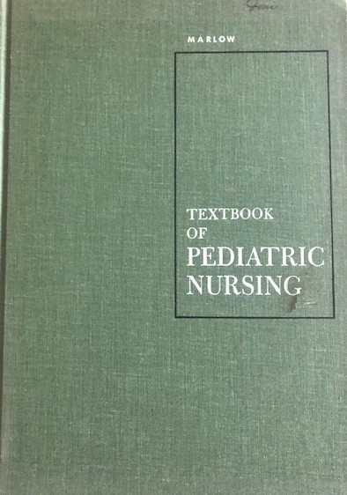
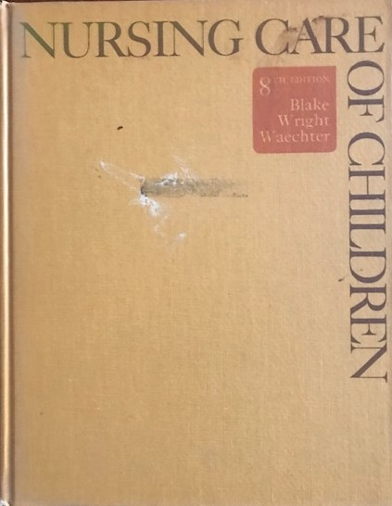
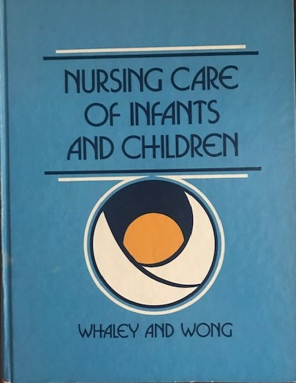
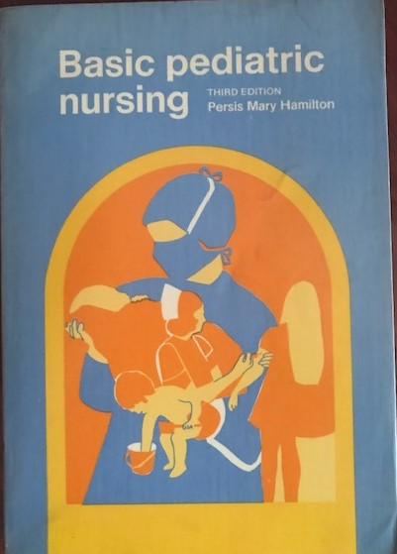
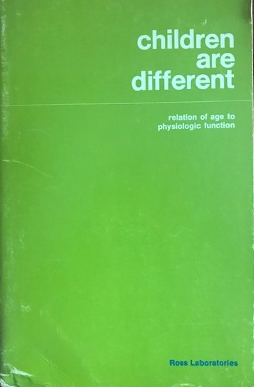
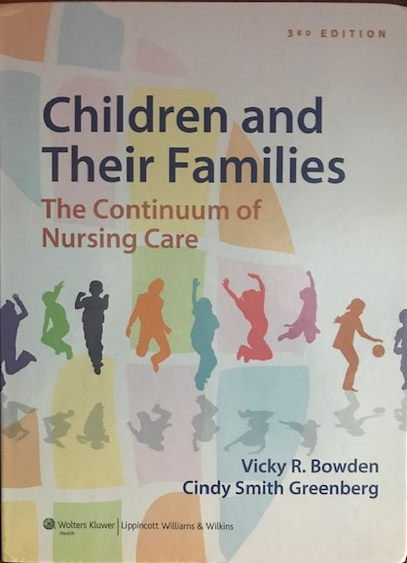
Pediatric Nursing Textbooks

Slide 35
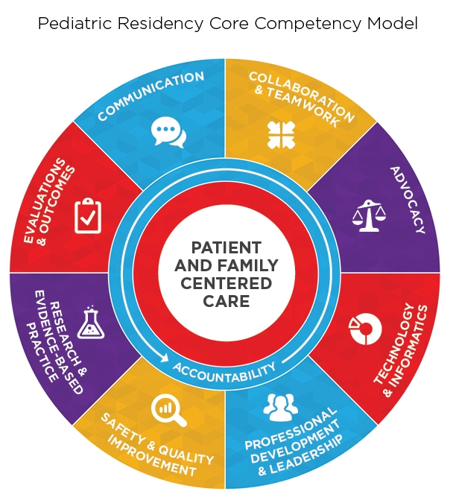
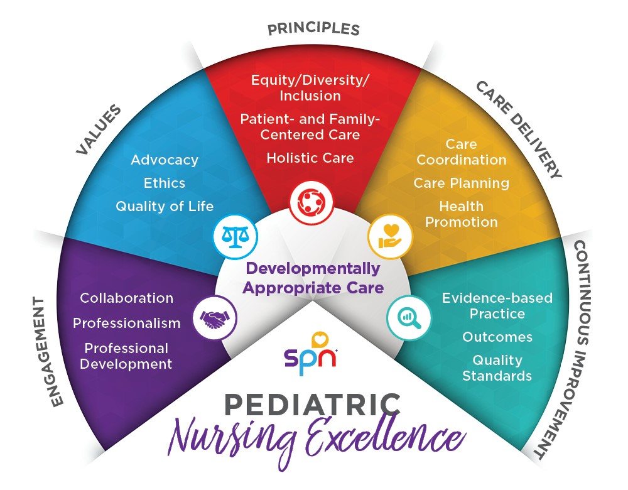
MAKING PROGRESS FOR CHANGE INPEDIATRIC NURSING
Pediatric nurse residency programs promoted both transition & retention into practice (Delack, McCarthy, Martin, & Sperhac, 2015)
Magnet designation promoted application of clinical nursing EBP and research (ANCC,2017)
Creation of SPN competencies for pre-licensure and residency programs established standards of excellence in both (Mott et al., 2018)
Pediatric Excellence Model (SPN, 2022)

Slide 36
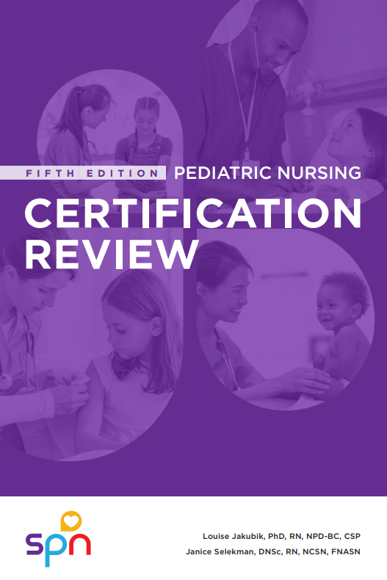
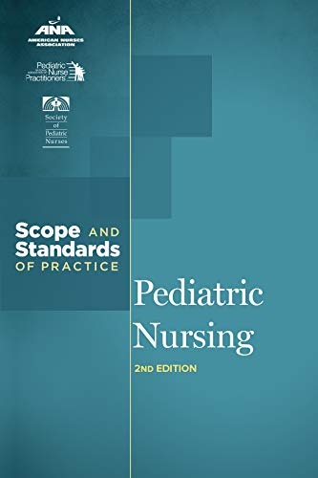
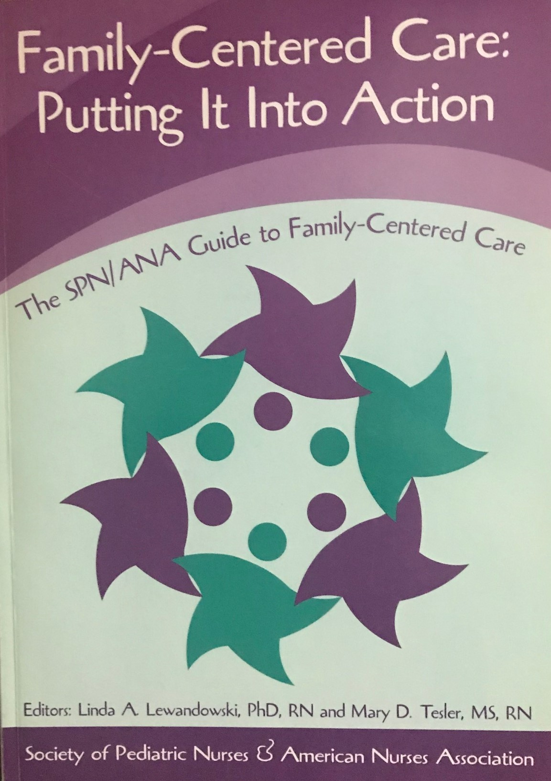
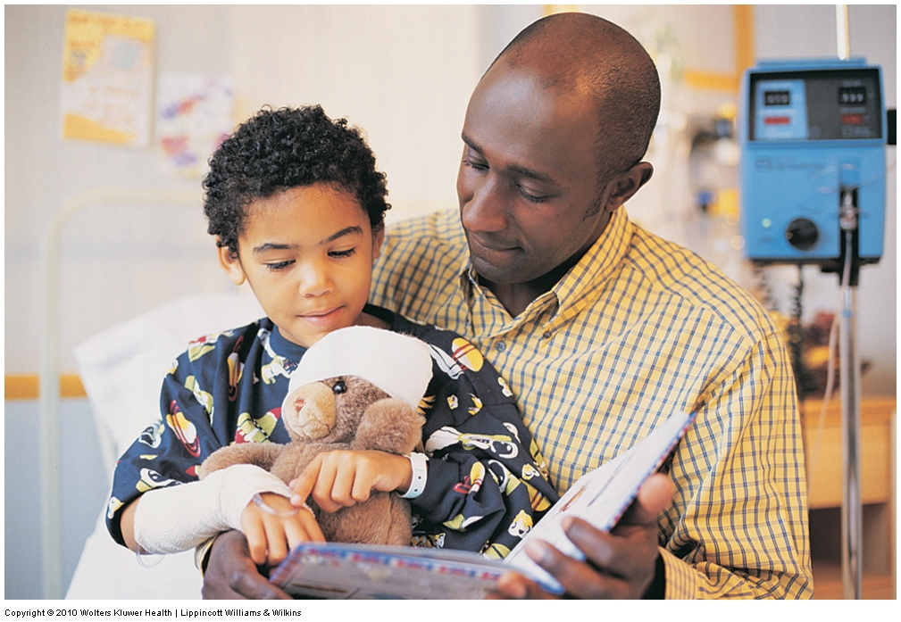
Pediatric Organizations: SPN 1990
Guidelines for practice
Scope and Standards
Family Centered Care
Position statements
Safe Staffing’
Access to Care
Importance of Immunization against COVID-19
Certification
Advocacy & Legislation
Seven priorities for advocacy
Notes:
Advocacy Priorities 2024
Nursing Staffing Shortages: The nursing shortage is having an overwhelming impact on our pediatric nursing community.
Pediatric Mental Health: There is a shortage of adequate resources for children with mental health issues. Pediatric nurses need to be equipped with assessment, knowledge and skills to provide beneficial and effective care to every child.
Pediatric Violence and Injury
Health Disparities: It is the responsibility of every pediatric nurse to advocate and understand how health disparities influence the provision of person-centered care.
Social Determinants of Health: SPN advocates and partners with key stakeholders to influence social determinants of health that impact children. 6. Sexual and Gender Identity: SPN advocates for the unique growth, development and emotional needs for the LGBTA+ pediatric community. Bills are being introduced challenging healthcare access for transgender youth in several states.
7. Pediatric Physical Wellness:

Slide 37
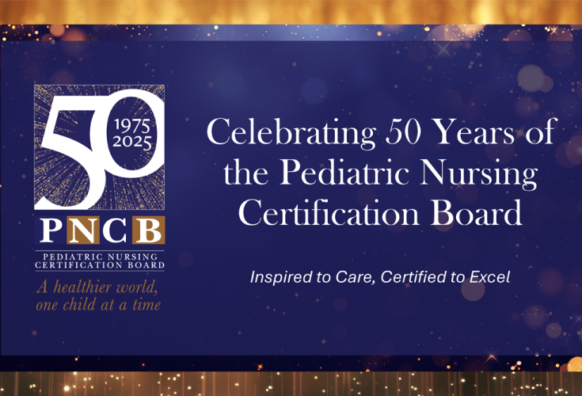
Pediatric Organizations: Pediatric Nurse Certification Board (PNCB)
Certification
ACPNP, PNP, CPN
Continuing education
Special programs
ACTivate Your Commitment to Adolescent Care

Slide 38
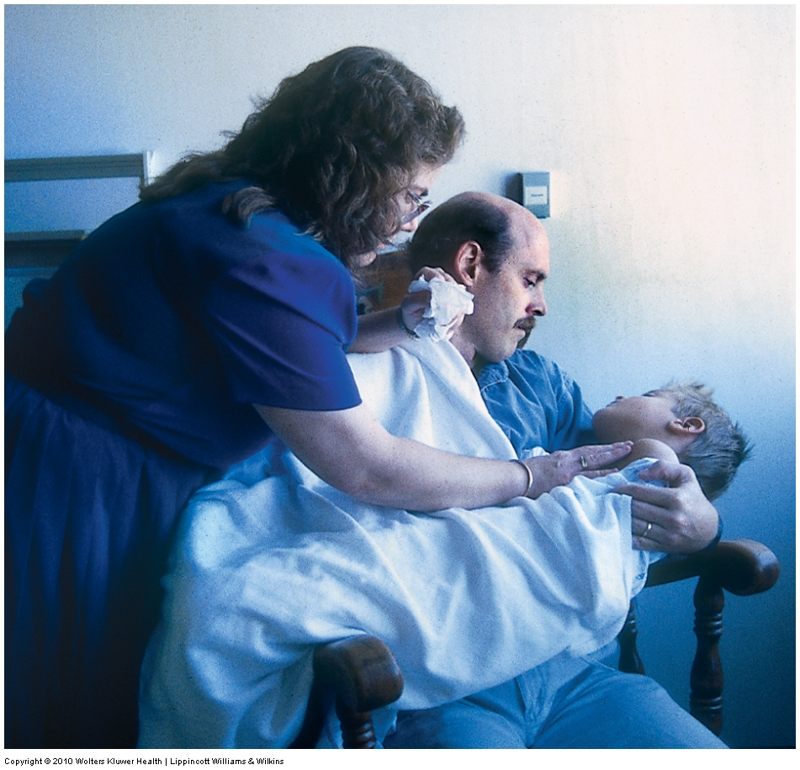
Organizations
American Nurses Credentialing Center (ANCC)
Certification RN-BC, courses, workshops
American Association of Critical Care Nurses (AACN)
Certification CCRN (pediatric/neonatal), courses, conference
American Academy of Pediatrics
Children’s Hospital Association
National Association of Pediatric Nurse Practitioners (NAPNAP)

Slide 39
PEDIATRIC END OF LIFE CARE
Nursing Leadership Academy in End-of-Life Care
Leaders from 22 organizations
The Initiative for Pediatric Palliative Care Project (IPPC)
To improve family-centered care for children living with life-threatening conditions.
Pediatric End of Life Nursing Education Consortium (ELNEC)
Precepts of Palliative Care for Children/Adolescents and Their Families.
Document produced in collaboration with National Association of Neonatal Nurses and the Association of Pediatric Oncology Nurses.

Slide 40
What do you see as the Most Pressing Issue in pediatric Nursing today?

Slide 41
Pressing Issues in Pediatric Nursing today
Rise in mental health needs
Advances in pediatric medical technology
Shift toward Family-Centered and Holistic Care
Increasing prevalence of chronic and complex conditions
Shortage of pediatric nursing staff

Slide 42
Pressing Issues in Pediatric Nursing today
6. Health equity and social determinants of health
7. Immunization and public health challenges-
vaccine hesitancy and misinformation on the rise
8. Legislative and policy changes- shifts in Medicare
funding, school health policies, nurse practitioner authority
9. Need for increased advocacy- nurses can have a
strong voice –Most trusted profession in U.S.
10. Emphasis on Evidence-Based Practice (EBP)

Slide 43
What Factor do you see as Most Impacting the Future of pediatric Nursing?

Slide 44
Factors Affecting the Future of Pediatric Nursing
1. Technological Advances- AI-driven diagnostics, Telehealth,
wearable monitors, digital therapeutics
2. Complexity of Care- Children with chronic conditions, Mental health
issues, children living with complex medical needs, health disparities and
Digital Health
3. Workforce Challenges- Staffing shortages, retention, burn-out,
need for increased specialization, workplace violence

Slide 45
Factors Affecting the Future of Pediatric Nursing
4. Parental Involvement and Expectations – PFCC, Parents
with access to information of varying accuracy
5. Health Policy, Politics and Advocacy- Child Health insurance
and access--? Future of Medicaid, political influences on health policy,
vaccine programs, and prevention public health initiatives
6. Climate Change and Environmental Health- Children are
more vulnerable to air pollution, extreme weather, infectious disease
spread

Slide 46
What Brings you the most Joy as A pediatric Nurse?

Slide 47
Let’s Take a selfie of the Future of Pediatric Nursing!

Slide 48
Great has been our past,
Wonderful is our present,
And glorious can be our future!
Gordon B. Hinckley
Thank you for all you do for children and families!
Linda & Lynn

