Slide 1
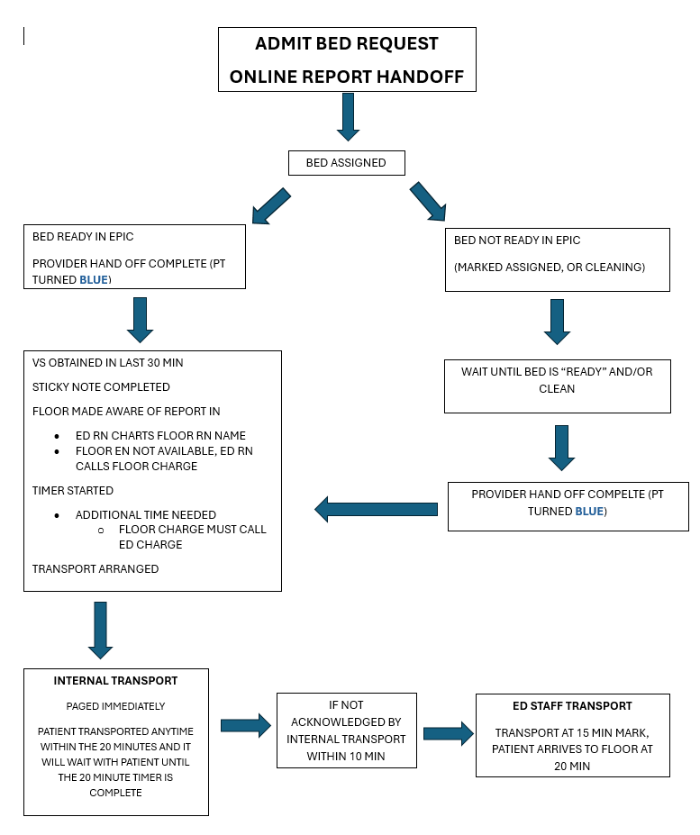
Minutes Matter: Enhancing Patient Flow from ED to Inpatient with Digital Handoff: A Quality Improvement Project
Jennifer Vaughan MSN, RN; Amanda Caipo BSN, RN, MHA, CPEN
Children’s Health, Dallas, Texas
Background:
Synthesis of Literature:
Delays in patient transitions from the Emergency Department (ED) to inpatient units are a persistent barrier to timely care.
Inconsistent nurse-to-nurse handoff communication
Lack of standardized processes
Delays in transport after admission
Resulting impacts:
Communication errors
Prolonged ED length of stay
Slower room turnover
Standardized electronic handoff tools improve communication accuracy and completeness during Emergency Department (ED) to inpatient transitions
Implementation of structured electronic handoff processes is associated with reduced ED length of stay and improved patient flow
Electronic handoff systems within the electronic health record (EHR) support more efficient interdisciplinary communication and patient throughput
Consistent handoff practices enhance patient and family satisfaction while promoting accountability and consistency among nursing staff
Project Goal:
Improve the safety and efficiency of Emergency Department (ED) to inpatient admissions by standardizing nurse-to-nurse handoff communication and reducing patient transport delays to ensure timely transition to inpatient units.
Project Timeline:
April 2024- Sept 2024
Online report rolled out to all floors excluding ICUs
Bi-monthly meetings held with ED and Floor Leadership for process improvement
Continued struggle with transport times after “Report Complete”
Oct 2024-Feb 2025
Education via huddles, staff meetings and monthly education emails
Transport continued to be greatest barrier
Feb 2025
“Who can transport your patient” added to EPIC track board, assigning transport ownership
April 2025- July 2025
Partnered with Internal Transport (IT) to prioritize ED to inpatient transports
Revised Internal Transport process to allow transport prior to 20 min, IT to remain with patient for full 20 min to enhance interdisciplinary teamwork.
July 2025 ED designated role of ED Transport Medic created
July 2025- March 2026
“Report Complete to Departure” consistently below 30 minutes.
Ongoing education and discussion with bedside staff
March 2026
Bed Ready to departure decreased by 33 min since implementation
Q1 2026: 4,347 admissions with 33-minute faster admits vs. 2024, creating capacity for 600 additional patients per quarter.
Feb 2023- Aug 2023
Work group established to streamline ED to floor admission
ED/ Floor Leadership collaborated to draft online report template
ED to Floor admission average > 55 min
Sept 2023
Unit Council meetings and staff huddles held to collaborate with bedside staff
Report revised with frontline staff suggestions
Sept 2023-Feb 2024 online report build in EPIC
March 2024
Goal set for 20 min from report to room
Online report process trialed for 2 weeks with Med/Surge floor
Trial period complete, online report process implemented
Process map created
Results:
Discussion:
Next Steps:
Standardized EHR handoff improved timeliness, but transport remained the key bottleneck.
Targeted transport interventions reduced delays and improved overall ED throughput.
Multidisciplinary collaboration and accountability were critical to success.
Ongoing optimization needed to meet transport goals and further reduce total ED length of stay.
Achieve ≤20 min transport goal: Real-time tracking, EHR alerts, and automatic escalation at 15 minutes to expedite patient departure.
Improve accountability & performance: Ongoing audits, unit-level dashboards, and targeted feedback to sustain gains and address delays.
Streamline physician handoffs: Standardized workflows with parallel RN/MD handoff processes and defined time expectations.
Sustain & scale improvements: Embed into standard work, expand across units, and continuously monitor ED throughput and patient outcomes.
References:
1.Dahlquist, R. T., Reyner, K., Robinson, R. D., Farzad, A., Laureano-Phillips, J., Garrett, J. S., Young, J. M., Zenarosa, N. R., & Wang, H. (2018). Standardized reporting system use during Handoffs Reduces Patient Length of Stay in the Emergency Department. Journal of clinical medicine research, 10(5), 445–451. https://doi.org/10.14740/jocmr3375w 2.Hanais, G. (2024). Enhancing patient throughput from emergency department to inpatient unit with electronic handoff implementation. Master's Projects and Capstones. 1765. https://repository.usfca.edu/capstone/1765 3.Koo, J. K., Moyer, L., Castello, M. A., & Arain, Y. (2020). Improving Accuracy of Handoff by Implementing an electronic health record-generated tool: An improvement project in an academic neonatal intensive care unit. Pediatric Quality & Safety, 5(4), e329. https://doi.org/10.1097/pq9.0000000000000329 4. Potts, L., Ryan, C., Diegel-Vacek, L., & Murchek, A. (2018). Improving patient flow from the emergency department utilizing a standardized electronic nursing handoff process. The Journal of Nursing Administration, 48(9), 432–436. https://doi.org/10.1097/NNA.0000000000000645 5.Sanchez, L. D., Chiu, D. T., Nathanson, L., Horng, S., Wolfe, R. E., Zeidel, M. L., Boyd, K., Tibbles, C., Calder, S., Dufresne, J., & Yang, J. J. (2017). A model for electronic handoff between the emergency department and inpatient units. The Journal of Emergency Medicine, 53(1), 142–150. https://doi.org/10.1016/j.jemermed.2017.03.027 6.Sluder, A. & Gillespie, G. (2025). A quality improvement study to improve patient and family satisfaction through handoff of patient care between emergency department and inpatient nurses. Journal of Nursing Education and Practice15(3),33-3. DOI: 10.5430/jnep.v15n3p33

