Slide 1
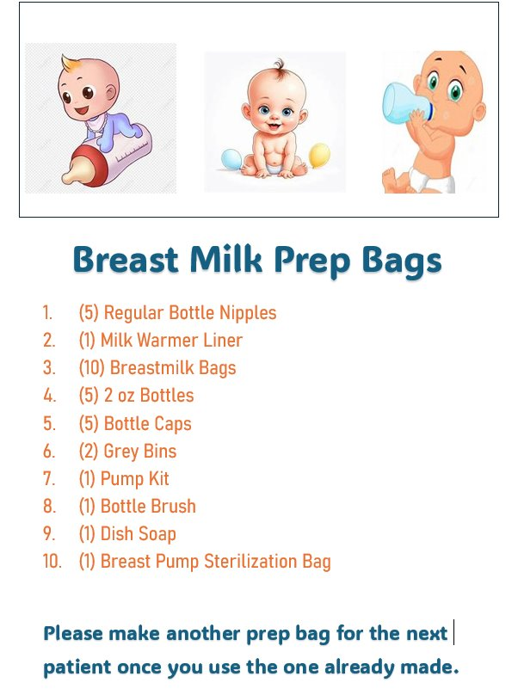
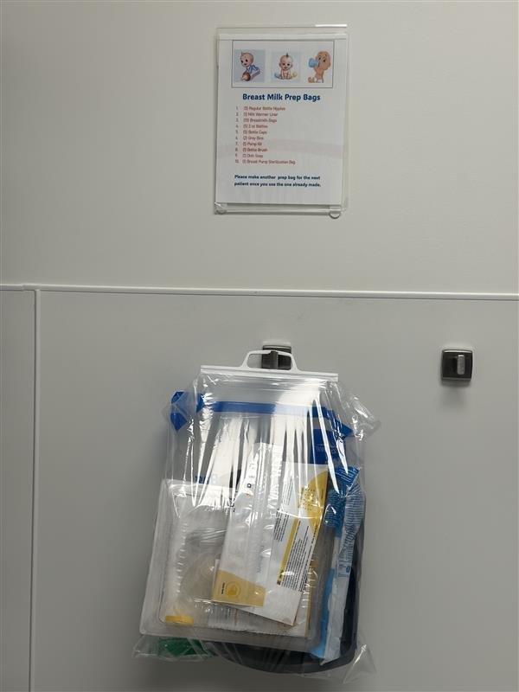
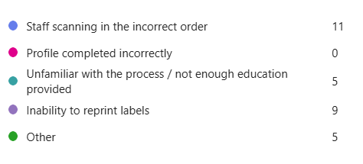
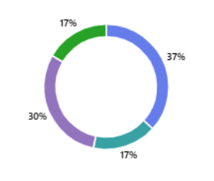
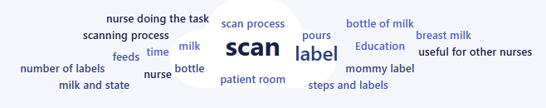
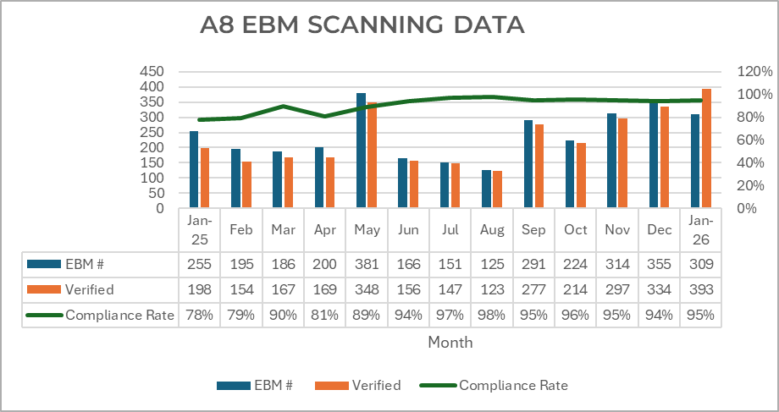

Got Milk? Increasing EBM Scanning Compliance with Nursing Led Initiatives
Angela Randles, BSN, RN, CPN, Rose Dela Cruz MSN, RN, CPN, Lily Lawrence, BSN, RN
BACKGROUND
This General Pediatrics unit had just 78% staff compliance in scanning Expressed Breast Milk (EBM) in January 2025, a crucial gap in safe handling and documentation.
The risk to patient safety prompted a targeted quality improvement project to improve compliance and workflow.
A thorough process mapping exercise and pre-survey bedside nurses helped understand noncompliance.
ACTION
With a detailed process mapping and pre-survey enabled nurses and leadership understand noncompliance.
In May 2025, charting system documentation capabilities were explored and found an unused field for accurate pumped and fed breast milk reports.
Visual cues on all staff computers reminded nurses to document
"EBM prep bags" were assembled and distributed upon admission to reduce supply gathering. Dissemination completed through weekly emails, staff meetings, UPC meetings and unit huddles
PURPOSE
The aim of this project is to identify ways to increase compliance with EBM scanning by understanding the root cause of non-compliance and identifying nurse led initiatives to improve patient outcomes.
EBM Prep Bags
EBM Scanning Barrier Survey
Question: How do you feel like the breast milk scanning process could be overall improved?
IDENTIFIED BARRIERS DURING IMPLEMENTATION
In April 2025, improper reporting of breast milk pumping and feeding versus label scanning caused 75% of compliance issues.
Some barriers identified include confusion and missed scanning opportunities resulted from this documentation gap which caused misunderstanding and skipped scanning opportunities.
Additionally, in December 2024, this unit was transferred to the new tower as part of the expansion, making compliance challenging due to the new layout and increased care space distance.
OUTCOME
In July 2025, a post-survey showed considerable improvements in staff confidence and workflow efficiency. Nurses reported visual reminders, the new documentation field, and prep bags reduced their burden and enhanced their confidence in scanning and documenting EBM. Compliance increased considerably from 78% in January 2025 to maintaining >90% to date.
ACS A8 Expressed Breastmilk Scanning Data
IMPLICATION FOR PRACTICE
This project shows how nurse-led innovation and collaboration affects pediatric nursing. An increased patient safety, documentation accuracy, and workplace support by listening to nurses, identifying system-level barriers, and implementing realistic, low-cost actions. This strategy shows that empathy, data, and teamwork can lead to substantial change in pediatric nursing in the present healthcare setting.
We would like to thank the Plano A8 ACS team members, A8 Unit Practice Council, Clinical Educator, CNS and the Neonatal Quality Program leaders for their support and guidance with this project.
Contact Information & References

