Slide 1

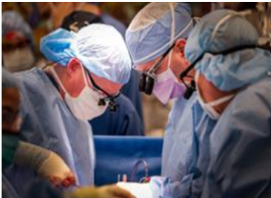

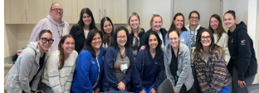
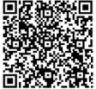


Gift of Life:
An Interdisciplinary Approach to Heart Transplant Education
Alison Beach, MSN, RN, CCRN, NPD-BC
Purpose
Outcomes
To prepare for the launch of a new pediatric
heart transplant program, a comprehensive
curriculum was developed for nurses in the
Pediatric Cardiac Intensive Care Unit
(PCICU) and Operating Room (OR).
An interdisciplinary team valued creating a
digestible, but elevated curriculum for
frontline nurses caring for this vulnerable
patient population.
This team included:
Transplant coordinator
Clinical pharmacist
Medical director
Infectious disease physician
Nurse educator
Cardiothoracic surgeon
This institution's first pediatric heart
transplant was performed March 28, 2025.
• The shared learning environment fostered
valuable relationship-building among
nurses and the interdisciplinary transplant
team members.
• These established connections are critical
for ensuring ongoing alignment of
treatment plans and goals for pediatric
heart transplant patients and their families.
Next Steps
Ongoing training opportunities will be
available throughout the year to ensure all
staff members receive the necessary education.
Initiative
The Pediatric Heart Transplant Core Curriculum
Included a day-long course consisting of:
Lectures
Case studies
High-fidelity simulation
A game-based learning platform
Participants included:
PCICU nurses with proficiency in postoperative pediatric cardiac care
OR nurses with specialized cardiac surgery training
Additional hands-on precepting was completed at a leading transplant center in both the cardiac ICU and the Operating Room
References

