Slide 1



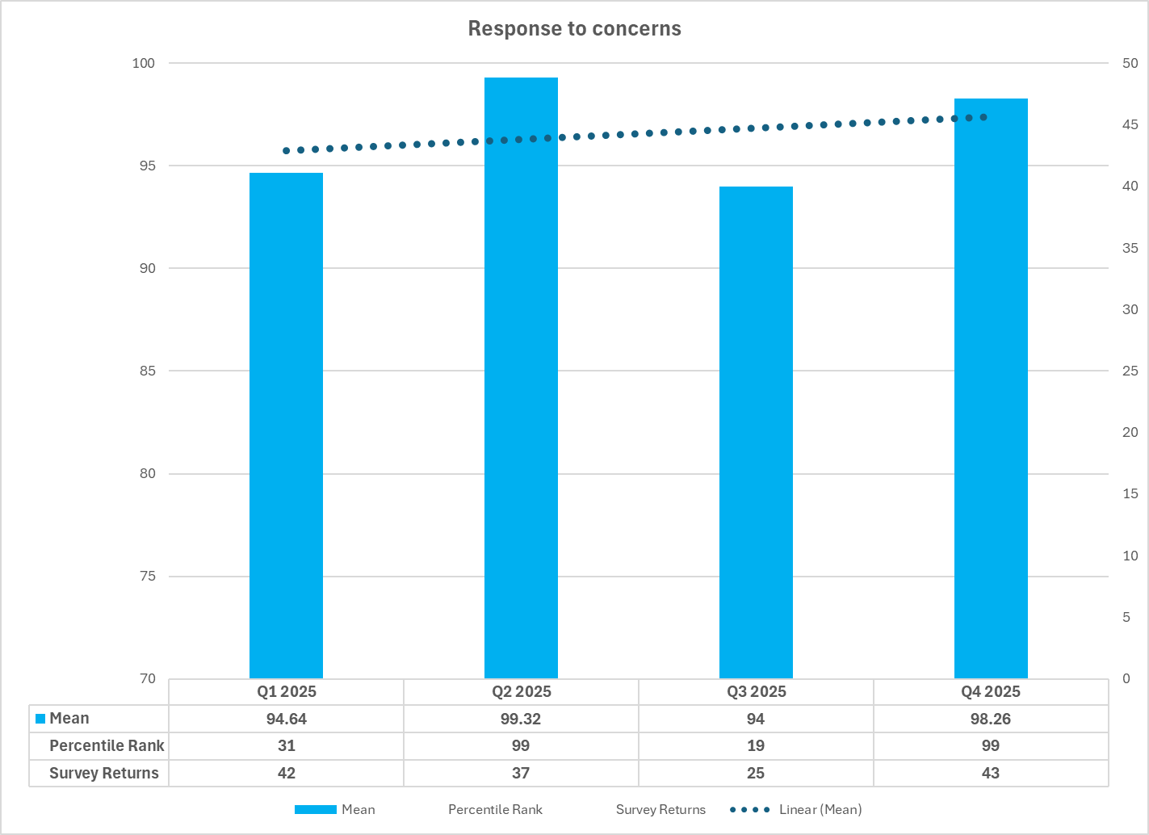
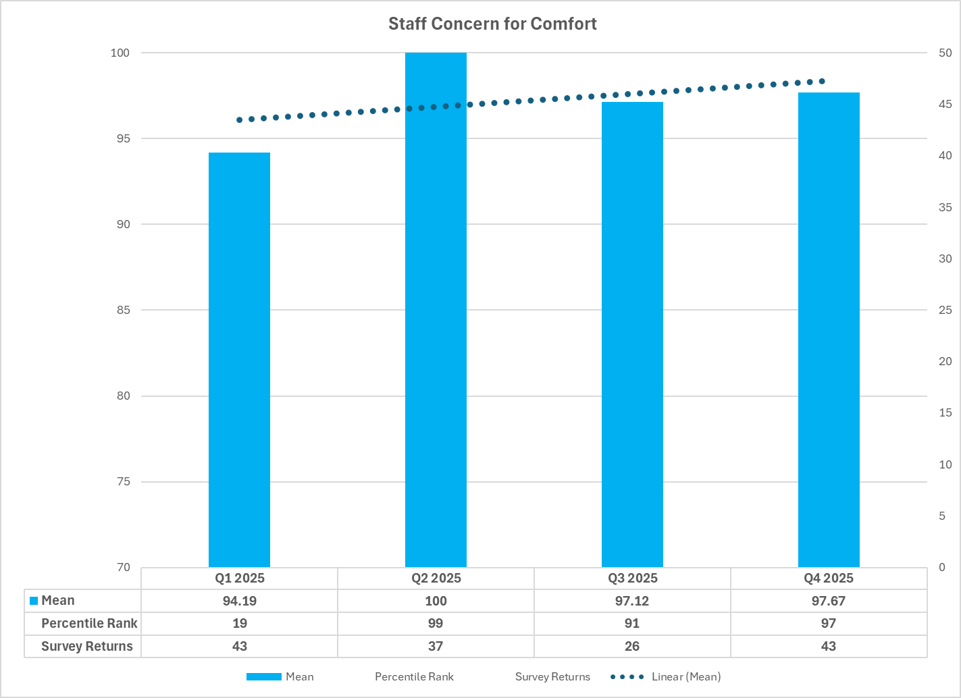
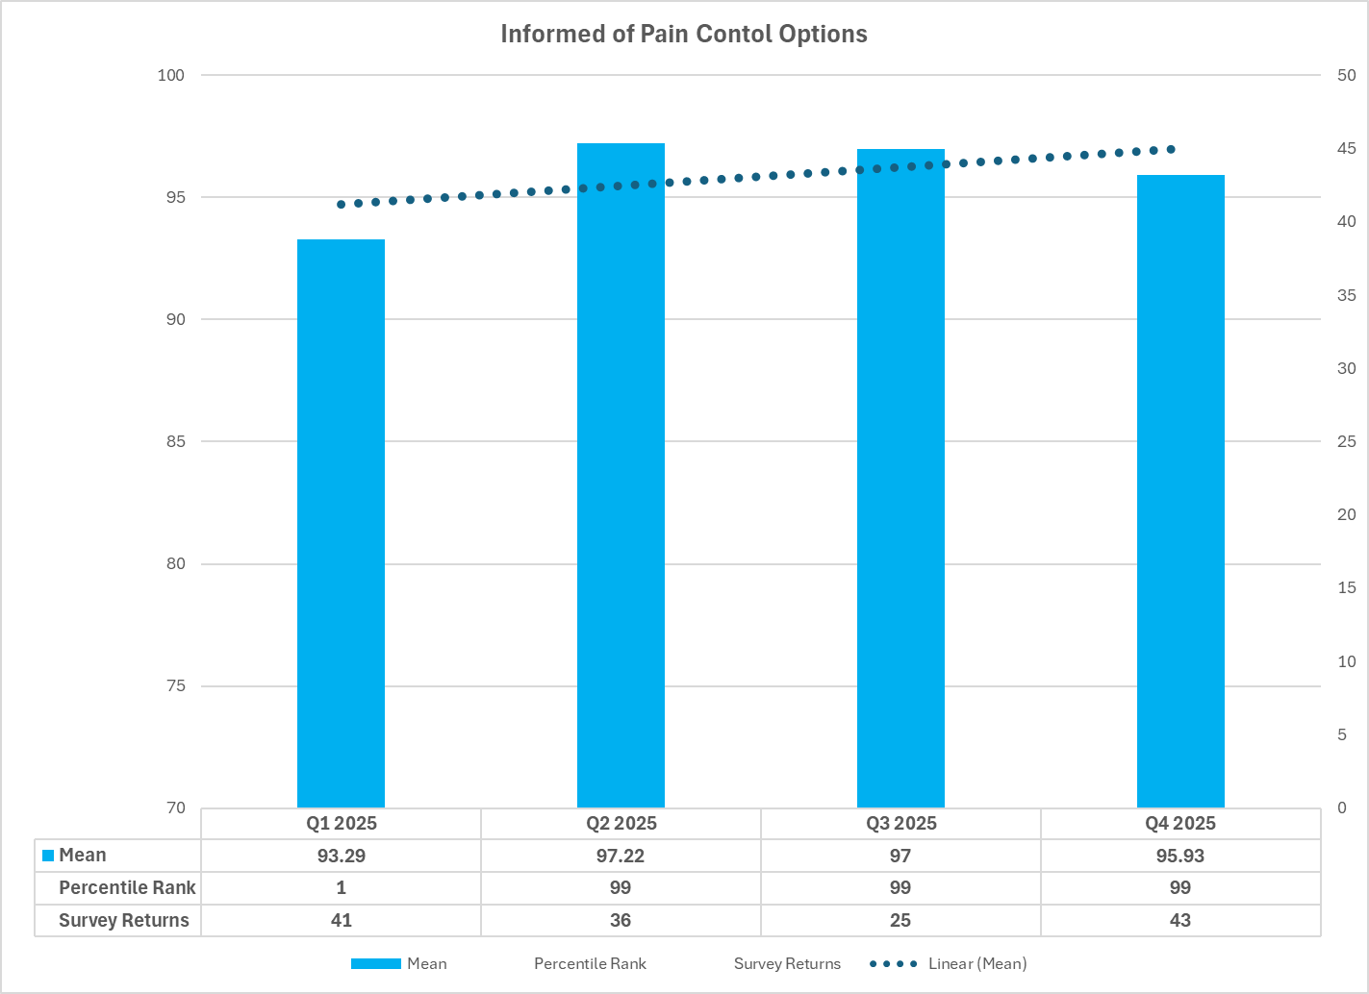


From Good to Great: A Feedback -Driven Project to Strengthen Pediatric Patient Experience
Judine Whyte-Foster BSN,RN, CPN and Mariagracia Ramjohn BSN, RN
Background
Results
Discussion
In the Pediatric Ambulatory Unit at Joe DiMaggio Children’s Hospital (JDCH) nursing- sensitive patient satisfaction indicators are central to evaluating patient and family experience. In the first quarter (Q1) of 2025 a decrease in select categories highlighted the need for renewed focus. The areas that identified for improvement were:
Response to Concerns
Staff Concern for Comfort
Informed of Pain Control Options
A proactive patient and family feedback survey conducted in early 2025 identified opportunities for improvement:
The survey asked 3 questions
What are we doing well?
What could we do better?
What could we do to enhance your experience?
Monitoring nursing-sensitive patient indicators is essential to maintaining high-quality care. In Q1 2025, several key metrics showed a decline compared to Q4 2024 data.
Following the implementation of the Pediatric Ambulatory Department Patient Satisfaction Project, ongoing quarterly monitoring of patient satisfaction data demonstrated a strong rebound in Q2 2025, with sustained improvements observed in subsequent quarters:
Response to Concerns: increased from 94.64 to 99.32
Staff Concern for Comfort: increased from 94.19 to 100
Informed of Pain Control Options: increased from
93.29 to 97.22
This project highlights the importance of continuous monitoring of data and responsiveness to patient and family feedback in sustaining high-quality Pediatric Ambulatory care.
The initiative illustrates how comfort enhancements, environmental adjustments, and structured follow-up can restore and improve patient experience, reinforcing patient and family experience as a critical quality metric.
This project provides a replicable model for a nurse-driven quality improvement efforts in pediatric ambulatory settings.
Section Title
Purpose Statement
The Ambulatory Department Patient Satisfaction project championed by the unit Shared Governance Council aimed to improve patient and family comfort by enhancing the overall experience in the outpatient ambulatory unit. This initiative utilized nursing-sensitive patient indicators and data from the proactive patient experience survey . The survey results were positive overall, highlighting both strengths and opportunities for improvement. Notably, responses related to noise levels and patient comfort stood out as key areas requiring focused attention.
Method
References
Implementation of a comprehensive comfort bundle:
Warm blankets
Socks
Sleep masks
Earplugs
Patient engagement strategies, including support from the Child Life team during procedures
Collaboration with the Patient Family Advisory Council (PFAC), including distribution of an informational letter outlining available services
Availability of Resource Center items (games, toys, books) for in-unit rewards
Purposeful rounding, incorporating real-time feedback from patients and families
Additional assistance for parents unable to leave the bedside
Expanded variety of nutritional options for parents
Installation of a charging station in the unit for family use
Personalized branded note cards provided upon discharge
Post-discharge follow-up calls conducted within 2–3 days after the visit
Amatt, N. G, C., Fothergill, C., Janes, A., Jones, K., MacMillan, K., McMillan, K., Savage., Minto, D., & Sheps, S. (2023). Pediatric nurse-sensitive outcomes: A systematic review of nurse-sensitive outcomes in pediatric settings. Journal of Pediatric Nursing, 72, 1-11.
Sullivan, C. E., Dickerson, S. S., Ryan, C., Kennedy, L., & Barba, M. (2022). Establishing nursing-sensitive quality indicators for pediatric care. Journal of Nursing Scholarship, 54(1),
105-114.
Ct
Contact
FIGHT THE UNFAIR
FIGHT THE UNFAIR

