Slide 1


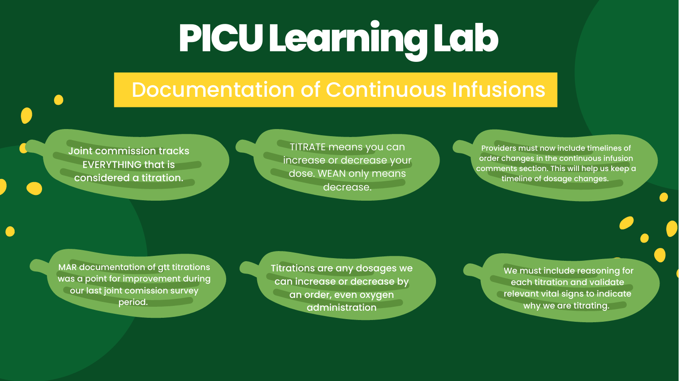


Enhancing Bedside Nursing Practice Through
Micro-Learning: Implementation of PICU Learning Lab
Aurora Colon, BSN, RN, CPN; Lauren Williams, BSN, RN, CPN
BACKGROUND
Adherence to evidence-based nursing practice is essential for patient safety and quality.
Practice drift in a pediatric intensive care unit (PICU) was exposing patients to avoidable risks.
Microlearning, the delivery of brief, focused education, can improve knowledge and confidence among nurses.
Smaller learning.
Safer care.
AUDIENCE AND PLANNING
Designed for direct patient care nurses in a 40-bed tertiary PICU.
PICU Quality Improvement and Education teams collaborated to design the PICU Learning Lab (PICULL), a quarterly micro-learning initiative.
Topics were selected based on event reports and quality data.
Content developed by subject matter experts in alignment with policy and practice guidelines .
Outcomes measured pre- and post-micro learning were
knowledge
confidence, and
compliance.
EVALUATION
Nurse knowledge and confidence improved when comparing pre- and post-assessments.
For a PICULL focused on continuous infusions, nurse confidence increased from 84% to 99%.
In another PICULL on an updated sepsis screening tool, 73% of staff answered all questions correctly after reviewing information.
Chart review and auditing reflected improvement in compliance with policy and practice guidelines.
ENGAGEMENT STRATEGIES
PICULL modules were rapid, scenario-based, and completed during the shift.
Engagement strategies included
clinical vignettes,
interactive questioning,
immediate feedback,
mandatory completion, and
leader follow-up.
IMPLICATIONS
Micro-learning is an effective, scalable approach for addressing practice drift.
Lessons learned include the importance of
content alignment with real-time quality data,
leveraging leadership to ensure accountability, and
brief and scenario-based training.
References
Monib, W. K., Qazi, A., & Apong, R. A. (2024). Microlearning beyond boundaries: A systematic review and a novel framework for improving learning outcomes. Heliyon, 11(2), e41413. https://doi.org/10.1016/j.heliyon.2024.e41413
Zarshenas, L., Mehrabi, M., Karamdar, L., Keshavarzi, M. H., & Keshtkaran, Z. (2022). The effect of micro-learning on learning and self-efficacy of nursing students: An interventional study. BMC Medical Education, 22(1), 664. https://doi.org/10.1186/s12909-022-03726-8
Kim, D., & Kim, G. (2025). Factors influencing pediatric nurses’ infection control practices: A cross-sectional study of standard precaution knowledge, self-efficacy, and organizational culture. Healthcare, 13(11), 1261. https://doi.org/10.3390/healthcare13111261
aurora.colon@cookchilsdrens.org
lauren.williams@cookchildren.org

