Slide 1
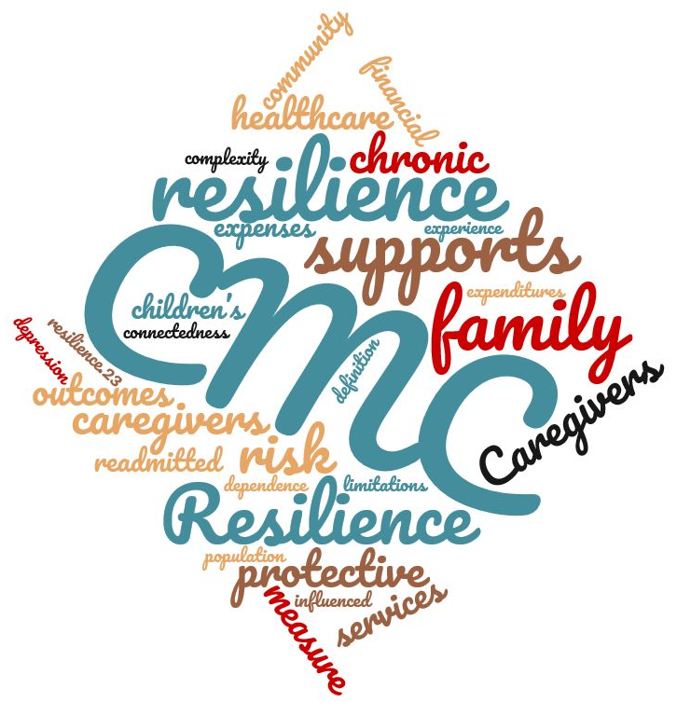
Feasibility of Studying Children with Medical Complexity and their Caregivers using Repeated Measures
Heather M. Kennedy MSN, RN, PCNS-BC, CCRN, CWOCN; Alexandra Cole MPH;
Laura Berbert MS; Michele DeGrazia PhD, RN, NNP-BC, FAAN
Background/Significance
Methods
Resilience Scale- 14 | Intake n (%) | 30 Day n (%) | 60 Day n (%)
 | 30 (100.0) | 26 (100.0) | 20 (100.0)
Mean: | 79.1 | 79.5 | 77.8
Median: | 83.5 | 83 | 83
Range: | [24, 98] | [35, 98] | [27, 96]
Standard Deviation: | 17.0 | 16.6 | 17.0
Very Low to On the Low End: | 9 (30.0) | 7 (26.9) | 6 (30.0)
Moderate to High: | 21 (70.0) | 19 (73.1) | 14 (70.0)
Children with medical complexity (CMC) account for 1% of the entire US pediatric population, but proportionally these children have more hospital readmissions, higher health care costs, and experience poorer health outcomes.
Past research has suggested a link between CMC caregiver resilience and hospital readmissions; however, this relationship has not been fully investigated.
This study provides preliminary information about this potentially important relationship and the need for a larger prospective investigation.
Study Design: Prospective, descriptive, repeated measures
Data Collection Tools: Surveys (Electronic or Paper)
Resilience Scale- 14 (RS-14)
Investigator Developed Caregiver Survey (Index, 30-Day, 60-Day)
Electronic Medical Record Review
Sample & Setting:
Convenience sample: Medical ICU & Intermediate Care Program
30 caregivers (legal guardians) of CMC experiencing an unplanned admission between December ‘19-February ’21
Data Analysis:
Descriptive Statistics
Qualitative Data Visualization
Purpose
To test the feasibility of employing a prospective, descriptive, repeated measures design to characterize CMC and their caregivers, community supports and services, caregiver resilience, and hospital readmissions.
Table 2. Resilience Scale Scores
Specific Aims
Results
To determine the feasibility of this prospective, repeated measures research design involving unplanned hospital readmissions of CMC as measured by enrollment, survey completion rate, survey item response rate, and participant attrition.
To describe the child and caregiver characteristics, community and family supports, caregiver resilience, and hospital readmissions following an unplanned hospital admission.
To examine relationships between caregiver resilience, child and caregiver characteristics, community and family supports, and readmissions.
30 CMC caregivers and their children participated.
Survey completion rates were 100% (index), 89.7% (30-day), and 69% (60-day).
Only 5 unique survey items had missing responses.
The 30-day CMC readmission rate was 37.9%.
CMC who were readmitted had a higher median number of home medications (17 versus 12).
CMC whose caregiver had an advanced degree did not experience a readmission.
All participants’ home care hours were only partially filled. The types and degree of CMC supports varied.
CMC caregiver open-ended responses revealed five categories (Figure 1).
CMC caregiver resilience was moderate to high (Table 2).
 | Surveys Administered | Surveys Returned
 | n | n (%)
Index | 30 | 30 (100)
Paper | 4 | 4 (100)
Electronic | 26 | 26 (100)
30 Days | 29 | 26 (89.7)
Paper | 4 | 2 (50)
Electronic | 25 | 24 (96)
60 Days | 29 | 20 (69.0)
Paper | 4 | 0 (0)
Electronic | 25 | 20 (80)
Conclusions
5 Categories Revealed in Analysis of
Open-Ended Responses:
All-consuming
Family Reliance
Impact of Covid
Taking Action
Broken System
Repeated measures using electronic surveys is a feasible study design with this caregiver population.
CMC caregiver resilience was moderate to high and remained constant over time.
The finding of inconsistent community supports for CMC is consistent with existing literature.
Caregivers reported their own unmet health needs because of the all-consuming care of their children.
Acknowledgements & References
Figure 1. Open-Ended Response Categories
Table 1. Survey Completion Rates
The full published manuscript can be found at: https://doi.org/10.1111/cch.13206
Heather.Kennedy2@childrens.harvard.edu

