Slide 1
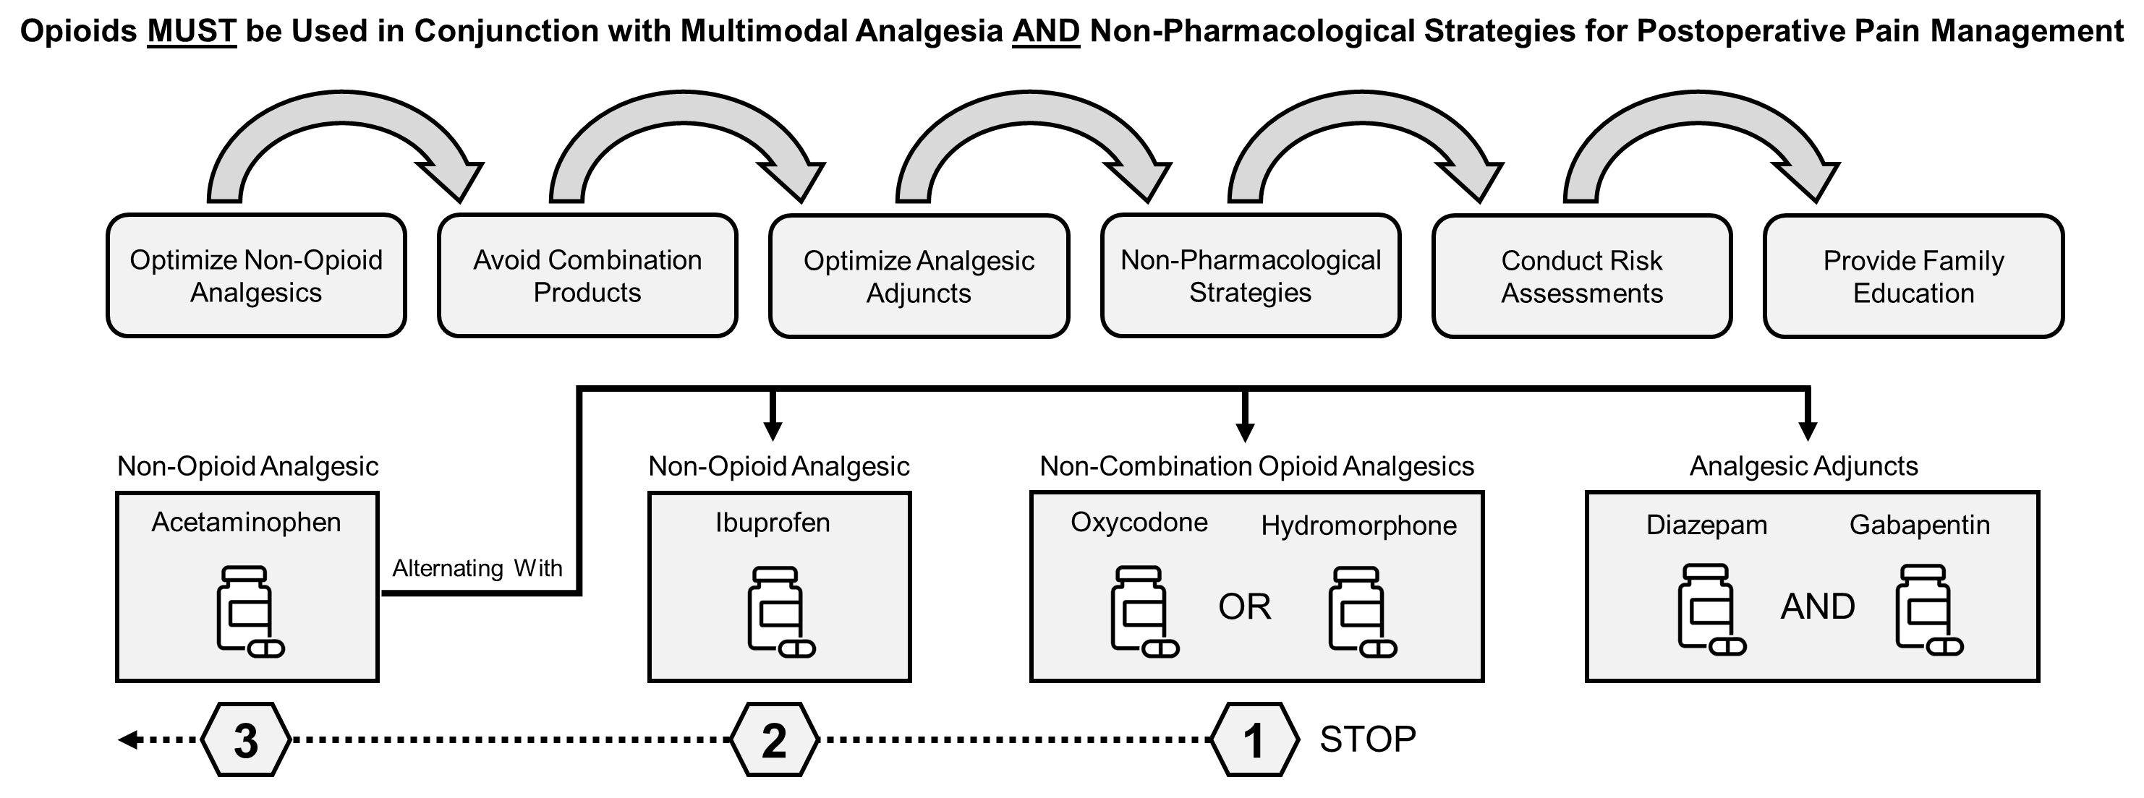
Improving Postoperative Pain Management Following Spinal Fusion Among Adolescents with Idiopathic Scoliosis
Ahmed Abdul Rahman¹, DNPc, RN; Sharon Norman^{1,2}, DNP, RN; Nancy Jacobs³, MSN, RN
Take Home Message: Multimodal analgesic strategies appear promising for managing postoperative pain in this patient population; however, further research is needed to understand the impact and risks of these strategies for minimizing opioid use post-discharge.
Background
Multimodal Pain Management Protocol
References
Results
Posterior Implemented Spinal Fusion (PSIF) is a common surgical procedure for correcting idiopathic scoliosis in adolescents
Despite advances in surgical technique, post operative pain management remains a significant challenge¹
Opioids are traditionally used as the first line for pain management but use is associated with multiple risks²
Research suggests that using a multimodal approach (MMA) that includes the simultaneous administration of two of more analgesics may reduce overall opioid consumption and improve pain management³
Higher diazepam use was associated with higher total opioid use as well as a higher number of opioid refill doses (p<0.001).
Patients who requested opioid refills were initially prescribed less opioid doses (p<0.046)
Gabapentin use was also associated with higher total opioid use, but did not reach statistical significance. (p=0.145)
Acknowledgements: This project was funded by grants from the Northwest Health Foundation and Oregon Clinical and Translational Research Institute.
Conclusions
Methods
Overall provider adherence to protocol was commendable for all medications analyzed
Gabapentin use was associated with higher total opioid use, which may indicate it was primarily used in patients with severe pain.
As gabapentin is opioid sparing, it may help to follow protocol more closely
The concerning finding that increased diazepam use was associated with increased total opioid use along with increased opioid refills should be addressed, as the combination of benzodiazepines with opioids can lead to increased risk of respiratory depression and accidental overdose
Prescribing appropriate opioid doses early in post-op course may help to reduce opioid refills in those patients who were initially prescribed less opioid
A retrospective chart review was conducted to identify adolescents age 13-18 admitted for a PSIF at a local orthopedic children’s hospital between Jan-Dec 2022
Data collected included: patient demographics, length of stay, type, dose, frequency and total number of doses of all opioids, analgesics, and adjuvants administered during hospitalization and prescribed at discharge
Inpatient prescription data was compared to the multimodal pain management hospital protocol to determine overall protocol adherence
Data of medication prescribed at discharge was evaluated to further analyze prescribing trends
Project Aims
Primary Aim: Quality improvement project to assess provider adherence to newly developed Multimodal Pain Management Protocol post PSIF
Secondary Aim: Assess opioid and adjunct analgesic agent prescribing post-discharge to evaluate prescribing trends
³
¹
²

Slide 2
A retrospective chart review was conducted to identify adolescents ages 13-18 admitted for a PSIF at a local orthopedic children’s hospital between Jan-Dec 2022
Data collected included: patient demographics, length of stay, type, dose, frequency and number of doses of all opioids, analgesics, and adjuvants administered during hospitalization and prescribed at discharge
Data was then compared with best practice guidelines to determine overall protocol adherence
Findings
Diazepam (p < 0.001) and Gabapentin (p = 0.145) were associated with more opioid use, which could reflect higher analgesic use (whatever was available) among patients who are in severe pain.

