Slide 1
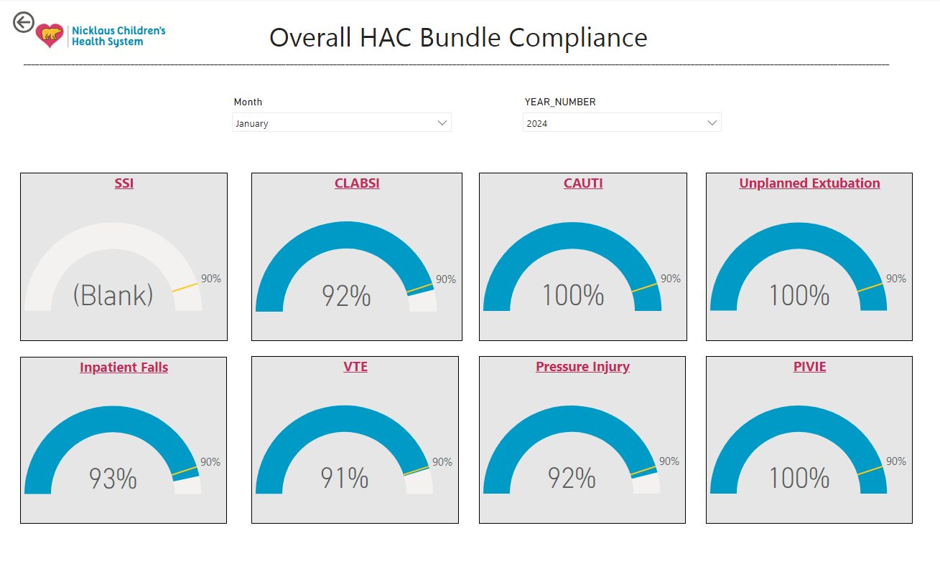
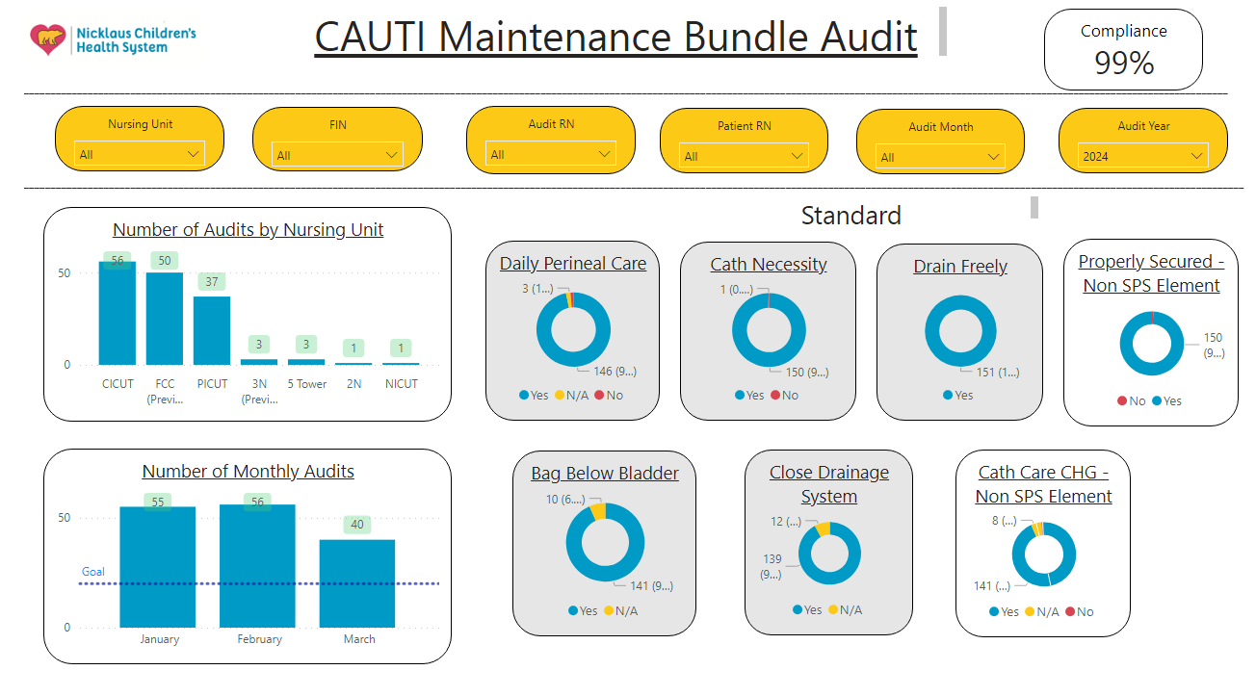
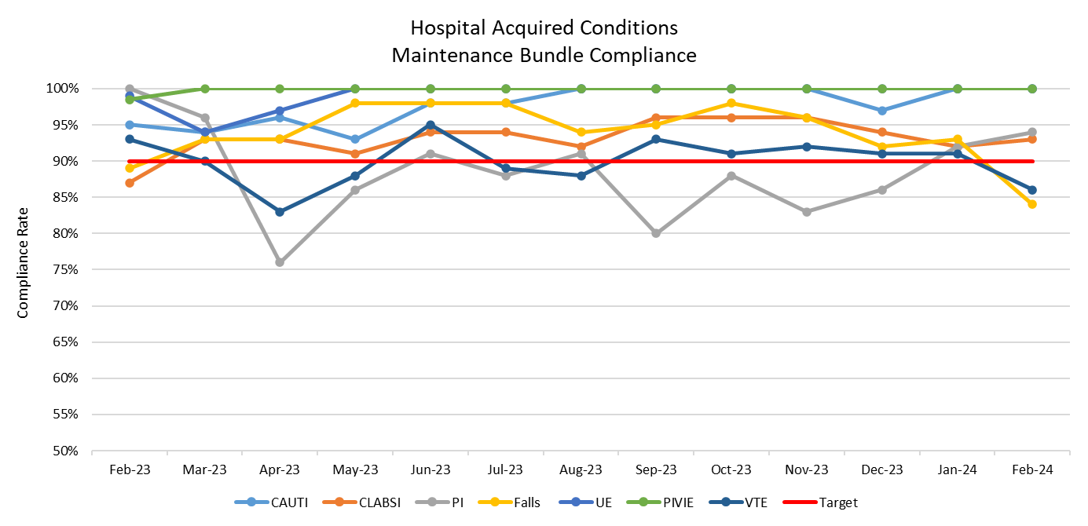
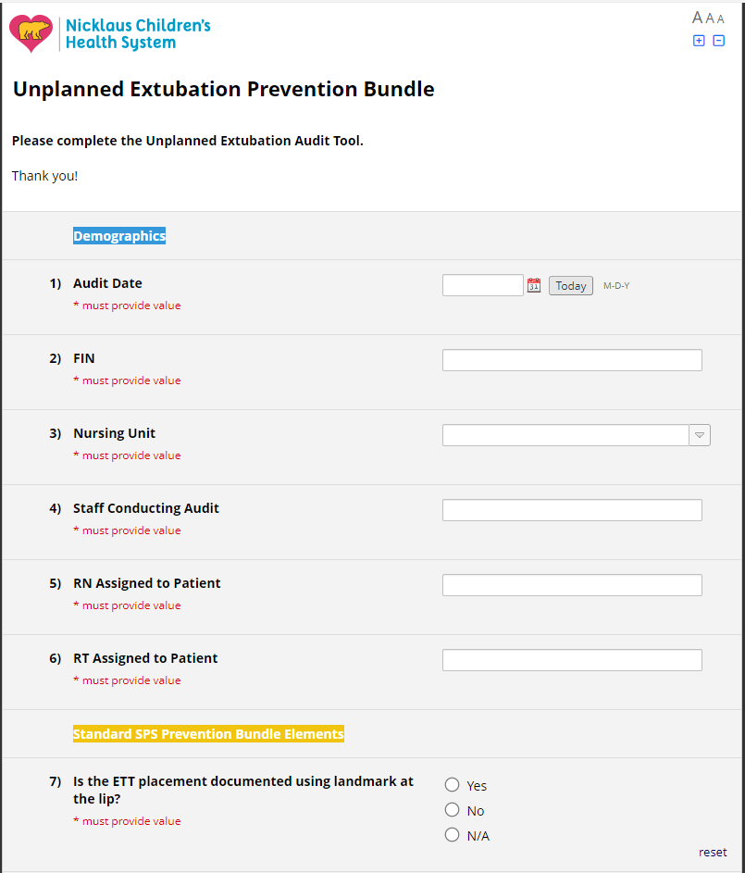
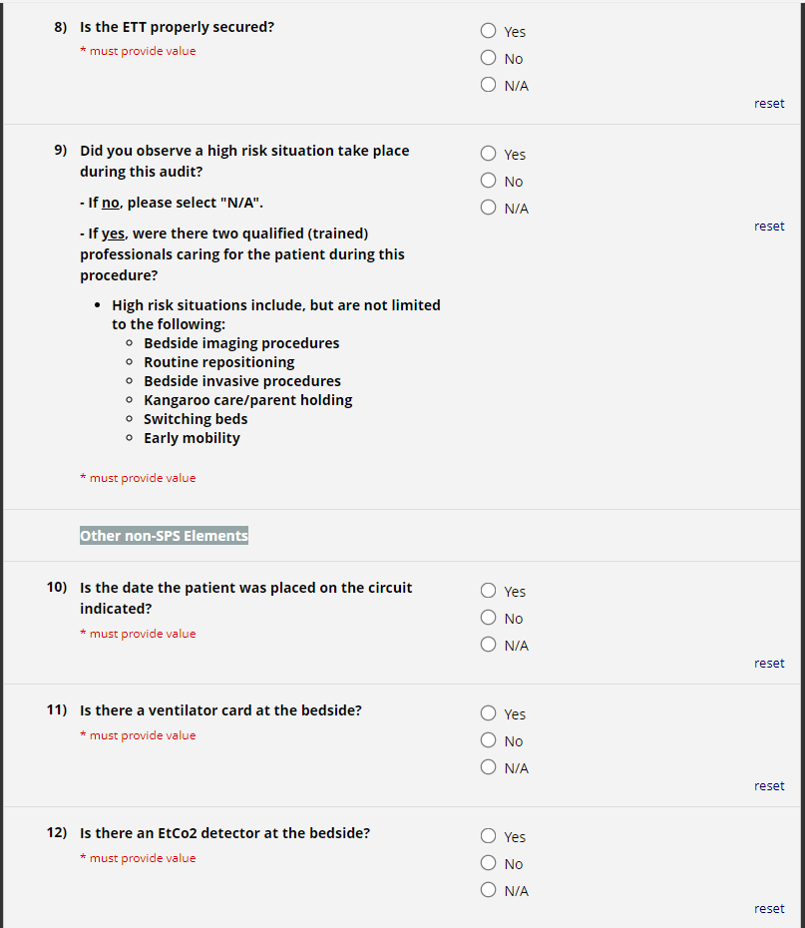
Achieving a Culture of Sustainability: A model for continuous quality improvement
Flor Tena, MSN-ED, RN, CBE,CCRN,
Jenny Cordo, DNP, RN, NE-BC
Jennifer Fernandez, BSN, RN, CPHQ, CPN
Nursing and Quality Department, Nicklaus Children’s Hospital, Miami, Florida
Purpose/Background
HAC Bundle Compliance Dashboard
Adopting evidence-based HAC prevention bundle elements and achieving high bundle compliance yields proven enhanced patient outcomes; however, sustainability is a frequent challenge.
Develop an innovative methodology for proactive and real-time prevention and monitoring of Hospital Acquired Conditions (HACs) to improve patient outcomes, the patient experience, and healthcare related expenses.
Annualized Bundle Compliance
Sample Audit Tool
Objectives
Describe innovative ways to proactively monitor HACs
Verbalize understanding of how to develop a data collection platform
Identify opportunities for real-time prevention and coaching of clinical nursing staff
Implementation
An interprofessional team analyzed current structures and processes of HAC prevention bundles
Identified various challenges not conducive to proactive safety, including reviewing audits at the end of the month and quarterly quality performance reporting.
Audits and chart review processes were manual, lengthy, cumbersome and data wasn’t available to address in a timely manner.
Created electronic data collection via Redcap audits
Developed an electronic HAC dashboard providing the Redcap audit data
A standardized interprofessional HAC Team model was created
Clinical nurses champion roles expanded to perform live observations for each HAC.
Results / Outcomes
Since implementation, there has been a notable and sustained improvement in all Hospital-Acquired Condition (HAC) prevention bundles. Over the last rolling 12-month period from February 2023 to February 2024, all HACs, except for pressure injuries, have consistently exceeded our target of 90%.
Despite pressure injury (PI) bundle compliance currently falling below target, we have observed an upward trend over the past four consecutive months, reaching 94% bundle compliance. Moreover, there have been zero pressure injuries recorded for the past three consecutive months. In 2023, our Venous Thromboembolism (VTE) target compliance rate was previously set at 77%, due to quality improvement efforts and our sustainability in compliance with bundle, we have successfully raised our 2024 target to 90%.
Essentially, our organization's continual dedication to reducing Hospital-Acquired Conditions (HACs) and our collaborative interprofessional approach have demonstrated success, reflected in consistently lower incident rates in 2023 compared to external benchmarks. These HACs encompass CLABSI, PI, Falls, UE, PIVIE, and VTE.
Conclusion
References
In conclusion, a proactive approach is needed to sustain good patient outcomes, establishing a culture where processes are simplified, information is readily accessible to be reviewed and data is analyzed frequently are paramount.
Decreasing variation in practices by developing a model where all processes, workflows and stakeholders' function in a standardized manner throughout all areas may help drive a culture of sustainability and ongoing efforts towards quality improvement initiatives.

