Slide 1
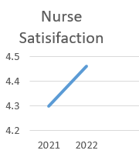
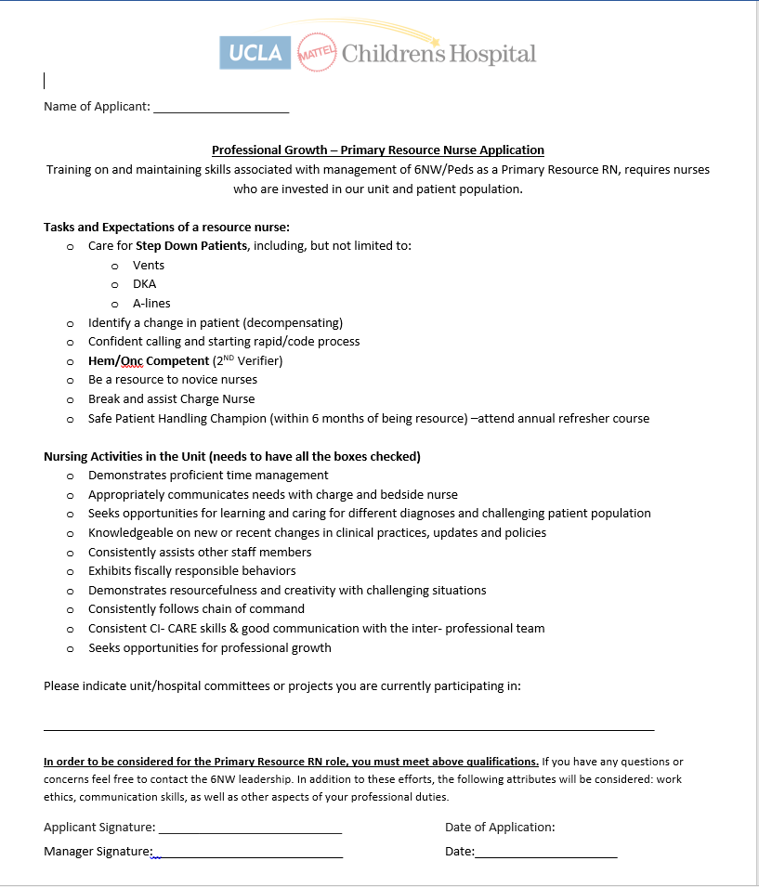
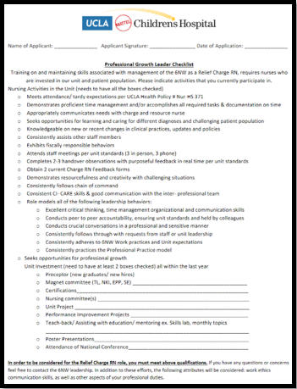
Taking Charge of Your Own Professional Development;
Applying to be a Lead Nurse - Charge and Resource Application
Sally Lozano RN, BSN, CPN, Adrienne Puglisi RN, BSN and Amy Goldberg RN, MSN, CPNP, NE-BC,CPN
UCLA Santa Monica Medical Center, Pediatrics
Background
Implementing Change
Effects of new Process
The general medical surgical 25 bed, pediatric unit cares for a wide variety of specialties.
This requires charge and resource nurses to have a diverse skill set and knowledge base.
Charge nurses play a crucial leadership role, overseeing the shift and collaborating with multi-disciplinary teams.
Resource nurses have a specialized role, helping nurses with their tasks, particularly in critical situations, until a patient can be transferred to the Pediatric Intensive Care Unit.
Welsh, Baer and Sessions (2020) found that goals set by an organization bring anxiety,
however goals set by oneself bring positive expectations and benefits.
An application process allows nurses to self-assess readiness and desire for responsibility
Ensures those selected have demonstrated necessary skills and experience
Helps identify nurses who possess required skills and knowledge to fulfill these important support roles.
Requiring nurses to apply for these positions demonstrates that these roles are indeed
leadership positions.
Reinforces importance of these roles and the value of nurses who take on these responsibilities
By empowering nurses to apply for these leadership roles when they feel ready, rather than based on staffing needs or management decisions, nursing satisfaction has increased.
After implementation, professional development increased from 4.38 out of 5 to 4.46.
Nurses now feel they have control over their career growth and can take on these roles when they believe they are prepared.
Change Is Made
Current Practice
In 2021 an application was developed to create a more structured approach to selecting and training new charge nurses.
More recently, in 2023, an application was created for the resource role.
Both applications encompass specific tasks and expectations for each role which helps nurses understand their responsibilities clearly
Encouraging current lead nurses to empowering staff to apply.
Discuss new applicants with current charge RNs in quarterly meetings.
Requiring nurses to apply for these positions verifies these roles are indeed leadership positions. This acknowledgment reinforces the importance of these roles and the value of nurses who take on these responsibilities.
Choosing the next charge:
Leadership would choose, based on managements' belief in readiness.
When unit is overstaffed used this opportunity to orient
Continue Improving
Yearly staff satisfaction surveys to follow progress.
Receiving feedback from staff that utilized application, and adjusting as needed
Quarterly Meetings – discuss applicants
Problem
Nurse would unexpectedly be assigned to orient to the Charge & Resource nurse role
Caused stress to the nurses, as they felt not ready for the role and responsibilities.
Stress remained even after a proper role orientation.
References
Notes:
SPN: The “Ws” (who, what, when, where and why) are effective details. • Introductory section: describe what is being studied or presented. • Data and methods section: list when, where, and how data analysis was conducted. • Include the names and affiliations of poster authors. • Left panel: research question or project purpose. • Middle panel: describe data sources, variables, sources, diagram, maps, and pictures. • Right panel: summarize findings, suggestions for further research, references

