Slide 1
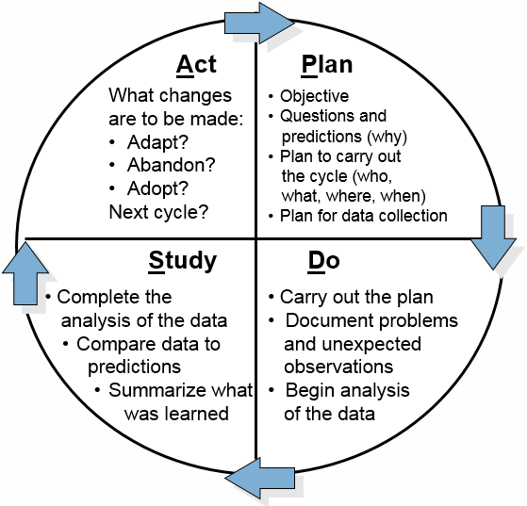
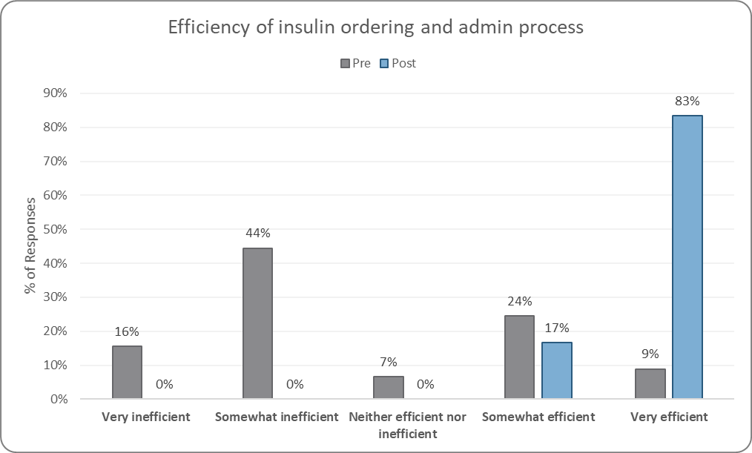
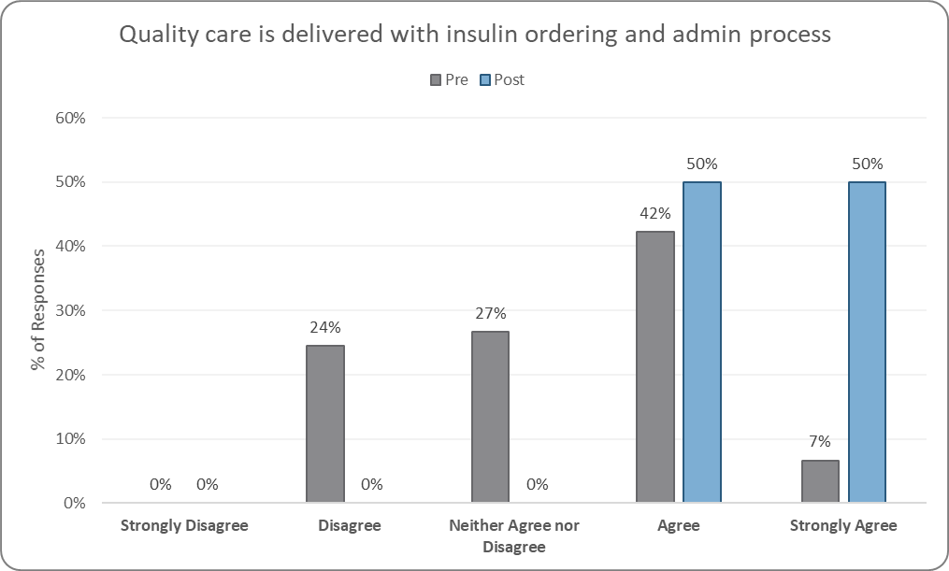
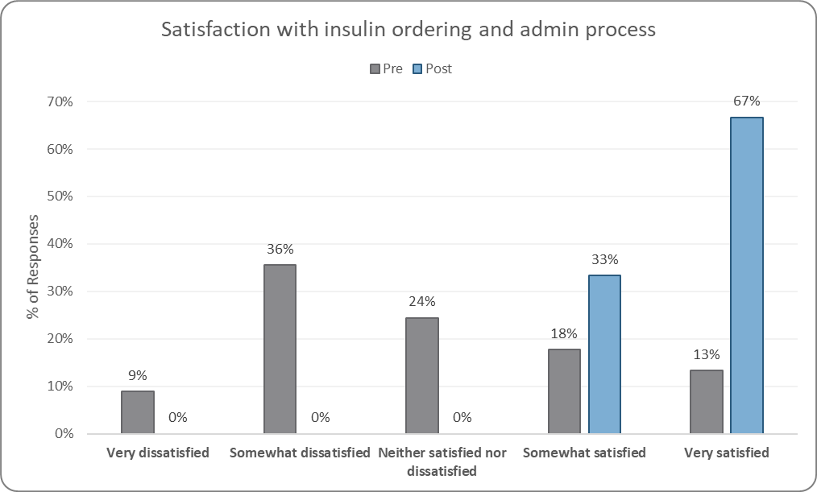
Insulin Calculator – Improve Patient Outcomes and Staff Satisfaction Meghan Moore MS, APRN, PCNS-BC, CPN
Background
Implementation Strategy
Description
Insulin dosing in pediatric patients is complex, each dose is specific to current clinical and nutritional circumstances. Prior to implementation of the insulin calculator, a new order was obtained for every bolus dose. This was a multi-step, multi-discipline process that led to delays in insulin administration. In addition, it was time consuming for nursing, providers, and pharmacy.
The Model for Improvement quality
improvement (QI) methodology was used for this project. PDSAs were utilized for each new change idea.
The insulin calculator is an electronic medical record tool embedded within the MAR (medication administration record). At admission, the provider enters the order and the pharmacist verifies it. This one order is used for all subsequent doses; this eliminated provider ordering and pharmacy verification with every bolus dose. For each dose, the nurse inputs patient lab values and carbohydrates to calculate insulin dose.
The insulin calculator was implemented on one unit. After 4 months of learning and improvements, the insulin calculator spread to more units. Eight month after initial go live, the calculator was implemented house wide.
Purpose
The global aim is to provide diabetic patients with optimal care and glycemic control. The process measure is the time it takes to provide patients with insulin, as measured by minutes from point of care blood glucose check to insulin administration.
Clinical Decision Support
To ensure a safe transition to the insulin calculator, multiple forms of clinical decision support were put into place. Tools included an order set, direct links to tip sheets from the order set, and best practice alerts (BPAs). Discreet data was embedded into the MAR administration window to provide nursing the most recent carbs, blood glucose, and ketones without having to navigate to other parts of the chart.
Results
Prior to the insulin calculator, insulin was administered within 30 minutes 48% of the time. Post implementation, administration within 30 minutes increased to 74%. Administration within 15 minutes increased from 18% to 56%.
Pre and post survey demonstrated that staff felt the insulin calculator was efficient, safe, and an improvement from previous workflow.
Conclusion
The insulin calculator is safe, effective, and can be used in other pediatric hospitals for inpatient insulin ordering and administration.

