Slide 1


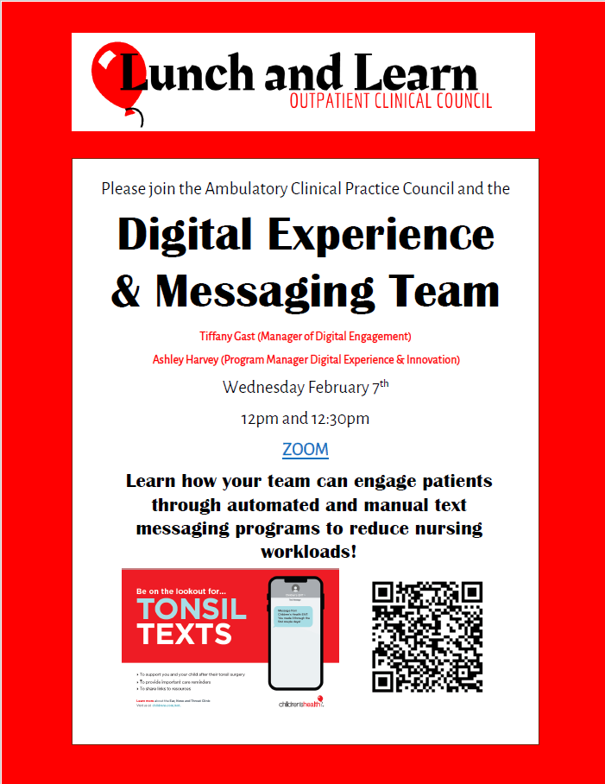
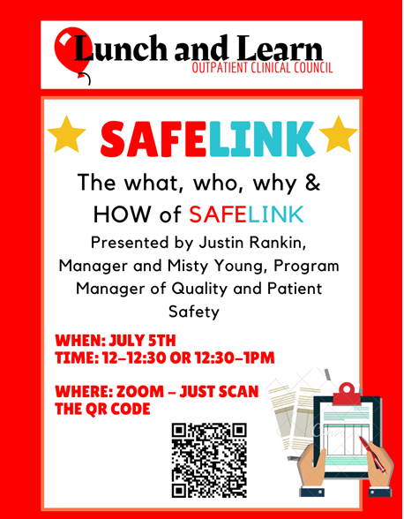

Lunch and Learn: How to Use an Online Platform to Increase Clinical Knowledge in the Pediatric Ambulatory Setting
Children’s Health - Dallas, Texas
Sally Derrick, BSN, RN, CPN
Background
A major challenge for a large pediatric healthcare system is the streamlining of practices across diverse clinical settings, creating forums for representation and providing opportunities for the distribution of relevant clinical information.
The Nursing Professional Governance Ambulatory Clinical Practice Council created a goal of
streamlining practices to educate and inform staff across diverse clinical settings, across multiple locations during a time of ever-increasing clinic volumes and workloads.
What’s Next?
The Lunch and Learn series is continuing in it’s current format. The council has added the addition of pre and post survey questions to capture learning outcomes. The questions capture how much the staff knows about the topic prior to the presentation and then at the conclusion of the presentation. This data will allow the council to more accurately tailor the lunch and learn series and share data regarding impact.
Who Are We?
Children's Health, a 4-time Magnet designated healthcare system, is located in North Texas, serving Dallas, Plano and the surrounding communities. The Ambulatory division encompasses five locations, with over 50 specialty clinics and 250 nurses spread out over a large metropolitan area.
Method
The Lunch and Learn was launched in November 2022 and provides a platform for monthly opportunities to learn more about topics that impact daily practice with the ultimate goal to improve patient outcomes. Two identical sessions are held over the lunch hour, each lasting 30 minutes. Offering two sessions allows for busy clinical staff to have options for attendance.
Topics are carefully chosen by front-line pediatric nurses who are members of the Clinical Practice Council and informal leaders of the division. The council members work together to identify educational needs across clinics as well as collaborate with ambulatory leadership to identify system initiatives. Once a topic is chosen a member of the council works with the appropriate department to create a 30-minute presentation that is offered virtually.
Contact Information
References
Abbott, P. A., & Coenen, A. (2008). Globalization and advances in information and communication technologies: the impact on nursing and health. Nursing outlook, 56(5), 238–246.e2. https://doi.org/10.1016/j.outlook.2008.06.009
Pilcher, J., & Bedford, L. (2010). Educational strategies in the NICU. Podcasts, webcasts, Sims, and more: new and innovative ways for nurses to learn. Neonatal Network, 29(6), 396–399. https://doi.org/10.1891/0730-0832.29.6.396
Growing and Thriving
Attendance for each session is tracked, with an average attendance of 85 participants per month, representing 34% of the ambulatory nursing staff. Closely monitoring attendance ensures that content remains relevant and engaging. Each session's length is also critical, as the council recognizes that staff are busy and find it challenging to step away for more than 30 minutes. To continue to encourage participation each month, staff’s time is respected, and the 30-minute timeframe is carefully maintained.
In December of 2023, one year since the launch of the Lunch and Learn series, a survey was sent out to all staff regarding the impact of the series. As seen in the graph above, all respondents found the series to be valuable, with 85% finding it very valuable.
Topics Presented
• Legal and Compliance Considerations
• Transition to Adult Care
• Social Determinates of Health
• Health Literacy
• Social Work and Case Management
• Tips for Writing a Nomination Letter
About Children’s HealthSM
Children’s Health℠ is the eighth-largest pediatric health care provider in the nation and the leading pediatric health care system in North Texas, providing a full spectrum of health care services—from daily wellness and primary care to specialty visits and critical care. Holding eight disease-specific care certifications from The Joint Commission, Children’s Health has been consistently named one of the nation’s top pediatric providers by U.S. News & World Report. The Children’s Health system includes Children’s Medical Center Dallas, as well as Children’s Medical Center Plano, multiple specialty centers, Our Children’s House rehabilitation facilities, physician services and the Children’s Medical Center Research Institute at UT Southwestern.

