Slide 1
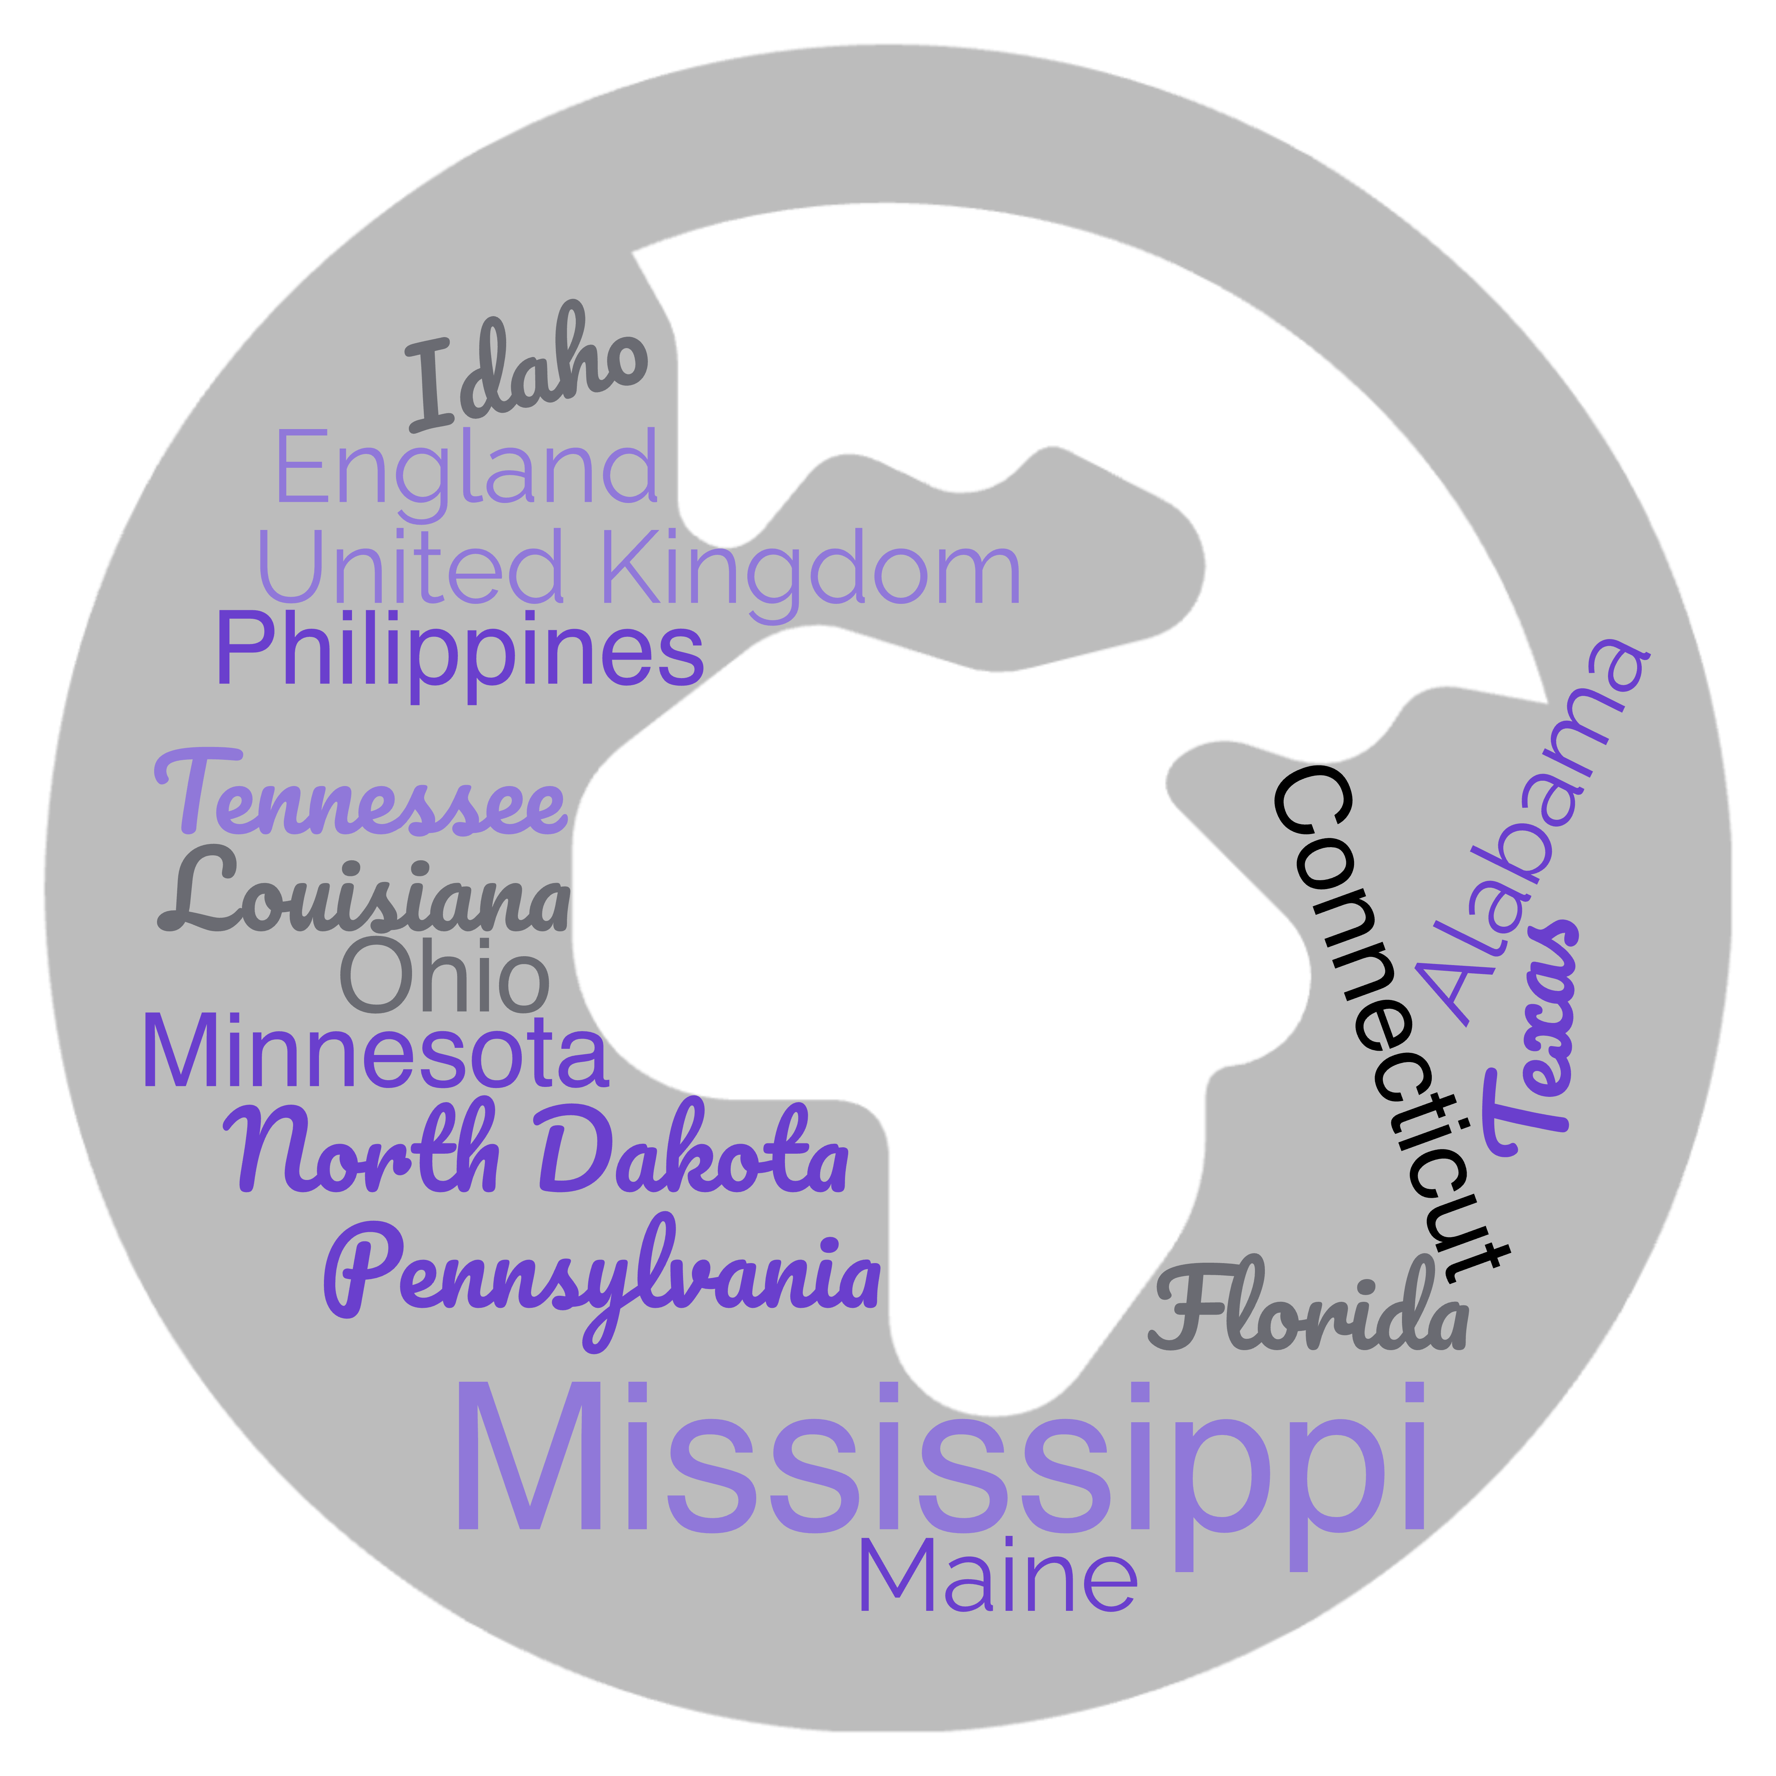
Ellen Johnson RN, DNP, CNE & Sally Clemenson RN, DNP, CNE, AHN-BC
Bereaved Parents: Navigating Hope and Coping through a Child’s Cancer Diagnosis
Background
Participants
Themes
Bereaved parental viewpoints on hope and coping during their child’s cancer journey is complex and subjective​
Hope:
Can alleviate distress
Is subjective and challenging to define​
Is often directed toward a cure or remission and has a wide range of meanings
Can be enhanced by positive experiences focusing on positive outcomes​
Can be a powerful coping strategy
Can be future or present orientated
Coping Strategies:
Formal vs informal
Effective vs ineffective
Purposeful homogenous sampling
Inclusion criteria:
Bereaved cancer parents
(A ‘parent’ is a mother, father, stepmother, or stepfather)
Exclusion criteria:
Parents who have lost a child to other reasons or child still living with cancer
Demographics:
n=60 (26 states, 6 countries)
Mother (95%) Father (3%)
Children who passed
Age range 1-43 years
Male (53%) (Female 47%)
Various cancer diagnosis
Time since death < 6 mo - >15 years
Faith and Looking at the Greater Good
Hope for Survival and a Normal Life
Hope for a Good Quality of Life
Giving up on Hope
Stressors Impacting Hope
Parents indicated several concepts affecting the ability to remain hopeful
Other children
Separation from family during treatments
Balancing needs of the family
The perceived inability of one parent to cope, led to relationship issues
Purpose
Geographical Location of Participants
Investigate the significance of hope and coping of bereaved parents during their child’s cancer journey
no
Methods and
Data Analysis
Descriptive qualitative design
Demographics-descriptive statistics
Qualitative data-content analysis
This Photo by Unknown Author is licensed under CC BY-NC-ND
Implications for practice
Nurse presence and rapport can impact hope
Parents are the experts defining hope during their children’s cancer journeys
The initiation of empathetic communication and facilitation of hopeful conversations are imperative
Nurses should engage in discussions regarding hope and integrate personal hope perspectives
Discussions on positive and negative coping strategies
Consider the Herth Hope Index (Rustoen, 2021)
Provide resources:
Counseling
Support groups
Respite care
Self-care
Future Reseach
Interview siblings
Interview additional family members
Intentional communication strategies
Complete the Herth Hope Index
This Photo by Unkwn author is licensed under CC BY-ND.
Contact us
References
Akard, T. F., Dietrich, M. S., Friedman, D. L., Wray, S., Gerhardt, C. A., Given, B., Hendricks-Ferguson, V. L., Hinds, P. S., Eunji Cho, & Gilmer, M. J. (2021). Effects of a web-based pediatric oncology legacy intervention on parental coping. Oncology Nursing Forum, 48(3), 309–316. CINAHL Plus with Full Text. https://doi.org/10.1188/21.ONF.309-316.
Barrera, M., Granek, L., Shaheed, J., Nicholas, D., Beaune, L., D’Agostino, N. M., Bouffet, E.,​& Antle, B. (2013). The tenacity and tenuousness of hope: Parental experiences of hope​ when their child has a poor cancer prognosis. Cancer Nursing, 36(5), 408–416.​ https://doi.org/10.1097/NCC.0b013e318291ba7d
Granek, L., Barrera, M., Shaheed, J., Nicholas, D., Beaune, L., D’Agostino, N., Bouffet, E., & Antle, B. (2013). Trajectory of parental hope when a child has difficult-to-treat cancer: A prospective qualitative study. Psycho-Oncology, 22(11), 2436–2444. Academic Search Premier.
Hockenberry, M., Haugen, M., Slaven, A., Skeens, M., Patton, L., Montgomery, K., Trimble, K., Coyne, K., Hancock, D., Ahmad, A., Daut, E., Glover, L., Brown, L., St Pierre, S., Shay, A., Maloney, J., Burke, M., Hatch, D., & Arthur, M. (2021). Pediatric education discharge support strategies for newly diagnosed children with cancer. Cancer Nursing,44 (6), E520–E530. https://doi.org/10.1097/NCC.0000000000000947
Kamihara, J., Nyborn, J. A., Olcese, M. E., Nickerson, T., & Mack, J. W. (2015). Parental hope for children with advanced cancer. Pediatrics, 135(5), 868–874.https://doi.org/10.1542/peds.2014-2855.
Nielsen, C. L., Clemensen, J., Holm, K. G., Jensen, C. S., & Callesen, M. T. (2022). Identifying parental needs when caring for a child or adolescent with cancer: Participatory design study. IProceedings, 8(1), 1–2. Academic Search Premier.
O’Brien, R. (2014). Expressions of hope in paediatric intensive care: A reflection on their meaning: The meaning of hope in paediatric intensive care. Nursing in Critical Care, 19(6), 316–321. https://doi.org/10.1111/nicc.12069
Sisk, B. A., Friedrich, A., Blazin, L. J., Baker, J. N., Mack, J. W., & DuBois, J. (2020). Communication in pediatric oncology: A qualitative study. Pediatrics, 146(3), 1–11. Academic Search Premier.
Rustøen, T. (2021). Hope: A Health Promotion Resource. In: Haugan, G., Eriksson, M. (eds) Health Promotion in Health Care – Vital Theories and Research. Springer, Cham. https://doi.org/10.1007/978-3-030-63135-2_6
Ellen Johnson, Assistant Professor
Minnesota State University, Mankato
ellen.johnson.2@mnsu.edu
Sally Clemenson​, Assistant Professor
Minnesota State University, Mankato
sally.clemenson@mnsu.edu
Acknowledgements: Hope Faculty Research Fellowship, the College of Allied Health and Nursing, and Minnesota State University, Mankato

