Slide 1
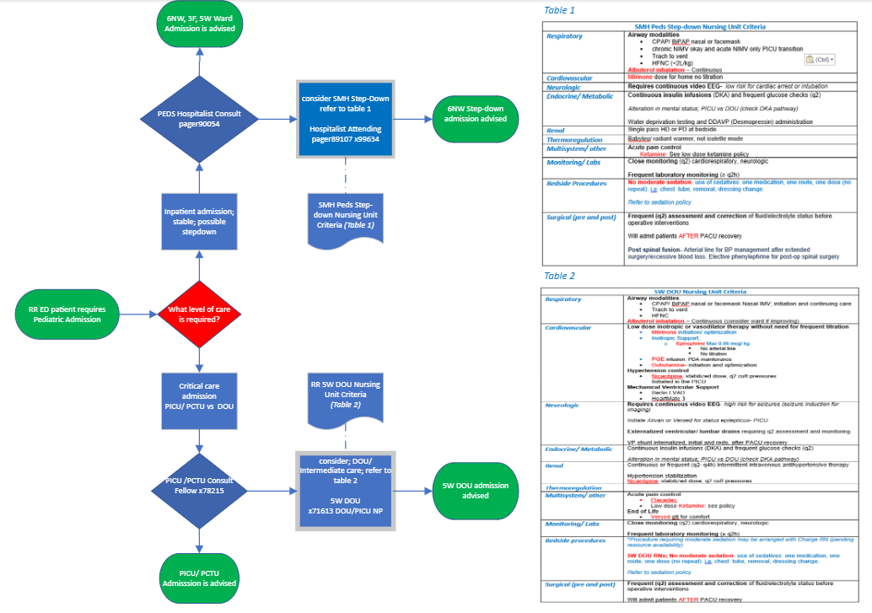
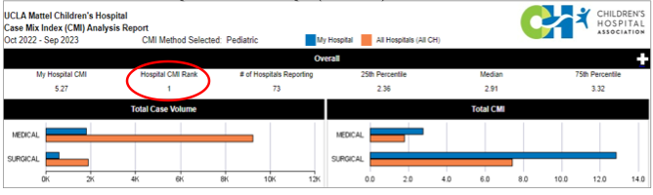
DOU, Where are you? A retrospective review of our efforts
in opening a new level of care for our
“not too sick “ PICU patients.
RJ Soliven MSN, RN, ACCNS-P Nikki Spencer MSN, RN, CPN Patrick O’Hare MSN, RN CCRN
Introduction
As a pediatric TQ center in a major metropolitan area, a care level between pediatric intensive care unit (PICU) and the pediatric ward is necessary to support a changing patient population. After comparing current unit practice, competencies across care settings and patient care needs, a training program is designed, implemented and evaluated to support pediatric nurses in staffing a newly opened pediatric direct observation unit (DOU).
After almost a year and a half in operations; we are back at Society of Pediatric Nurses (SPN) 2024 Annual Conference sharing our lessons learned; both challenges and best practices in our pediatric DOU.
Best practices include utilization of the latest guidelines for pediatric intermediate care (AAP, 2022) and defining facility parameters and modalities in each nursing area. Creating process map and decision support schematics to guide providers from neighboring departments when to refer patients in respective units.
The Peds Direct Observation Unit (DOU) provides a level of care to patients with medical complexity and allows the PICU to care for critically ill patients.
Methodology
Results
Utilizing Donobedian’s SPO model, we evaluated the necessary elements of opening a pediatric DOU. We have evaluated multiple perspectives on this effort and have heard from mainly our nurses; front line staff, leaders and advance practice providers. We also have reached out to our operational leaders and members of the interdisciplinary team.
The teams feedback is summarized and illustrated in
the results section
Structure
Equipment/ Physical environment
People; Training and education
Process
Clinical Guidelines
Policies and Procedures
Outcomes
Nursing quality indicators/ HACs
Patient flow/ capacity
Add your information, graphs and images to this section.
Nurse Training and Education
Room set-up/ carts
Defined clinical criteria- procedures

